Slide 1
Executive, Leadership, Org
Departments
Industry
z
z
z
Optimize Costs per customer/IT FTE/business FTE, do more for less, enhance value and efficiency, assuring solvency, return on investment, Worker/Customer/Stakeholder Intimacy, while achieving charter objectives and delivery on Key performance indicators
Report
Internal, programmable, directable, cybernetic, artificial, operational, and organizational synapse using opts, feedback, improvement
Report
External, programmable, directable, cybernetic, artificial, operational, and Industry synapse using ops, feedback, improvement
Report
z
z
z
Report
Operations
Customers
Program/Project PMO
Report
Report
Correlates, Dualities, Tuples, Mechanistic Links, Training Data and Tensors
z
Visualizations, Insight, Ideation, Playbooks and Derivatization
Data
Ocean Boundary
Shards and Columns from elastic search and map reduce
Industry, Customer
Meta Data enabled Correlates
Masterdata enabled Correlates
Lean Manufacturing enabled
Program/ Project Management KPIs
Executive, Solvency and Spend Objectives
Departmental
Objectives
External Data Sets
Data
Rapids
Lean Manufacturing
Value Synthesis, Customer Intimacy, Worker Intimacy
Scrubbing, Usability
Self-Service Fulfilment
Analytics
Prioritized Kanban Work List
What Org does not do well
What customer thinks makes them satisfied or makes them obtain services
Service Level Management
System Reliability
Statistical Process Control
Decrease Muda
What Org does do well
What Factors, statistic, indicators, or other actually makes customer happy or are correlated with customer activity
Management, Monitoring, Reporting,
Analytics
Metaverse
Metadata Management
Master data management for each data element, produced gradually, beginning with key fields, linked to Rapids or change data capture to provide a perspective of how the data changes, is removed, or is updated.
Statistical Process Control and Analytics
Master Data Management
Definition of key fields, standard calculations used to produce the key field, locations in data structures of the enterprise, location in applications and code used in the enterprise, what applications/processes/code change the value, what system or table/column is the source of fact, what stakeholders/sources/systems originate the data, redundancy check such as what fields comprise the one key field, which transactions/business transactions, business processes, workflow or business cycles use key field.
Data
Rapids
Change Data Capture, snapview statistics, rate of change, rows added, rows removed, values changed, process/application runtime, most frequent values, least frequent values, average values, aggregate number of rows, error logs, number of errors, most frequent error codes, number of instances of each error code, success volumes, pended transactions, security logging, transaction logging, etc.
Data
River
External Data sets for Analytical Correlations
Data Droplets
Data Droplets
Data Droplets
Warehouse
Mart
Reporting
Statistical Process Control
Raw
1,Raw
ETL/ Transform
External Stake
holders
Data Droplets
2, ETL/ Transform
Subject Oriented
ETL/ Transform
Function
Report
API,
Messaging
Time/View A
Function
Subscription
Data Hub
Data Puddles
Operational
Data
Sources
Time/View B
Function
Publication
Service Level Management
External Stake
holders
ETL/ Transform
Data Ponds
Time/View C
Data Pond
Operational Data Store
Data Lake
Data Swamp, Data that is stagnant, unused, not referenced by metadata, ungoverned, immobile.
API,
Messaging
Realtime Replicas, Branched Versioned Replicas, Masking, NoSQL Raw Data Publication, Backup, Index update Maintenance, IaaS, Agile, Scrum, Gestalt, Splunk, Elastic search
Usability
Data Platform as a Service, Data as a Product, CI/CD, Infrastructure as a Service, Platform as a Service, Microservices, APIs, Cloud, Containerization, Orchestration, Rest, MVA, WSDL
System Reliability
Self-Service Fulfilment
Frictionless Data, accessible, usable, agile, applicable and powerful

Slide 2
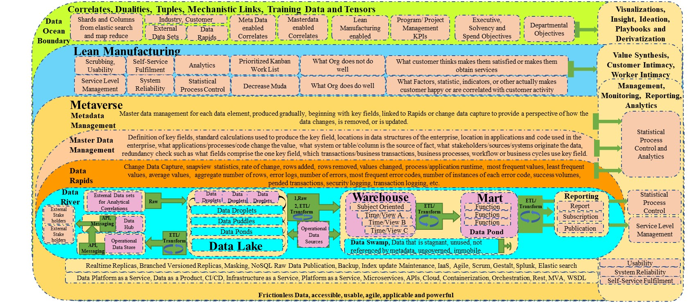
Development container from a Hub
Policy or On Demand Completion
Developer, Tools, IDE, Packages, Image/Container/StackDefinition/YAML or tools to build these, Machine or Virtual Machine for Development,
Database, Database Links, source repository Agent or source Integration Agent, Devops Deployment capability linked to Source Code Management and linked to Agent enabled Deployment Locations which are Dynamically configurable also (Data Kitchen, Delfphx for Databases, Ansible, Chef, Urban Code, Jenkins,
Devops and Dataops for Developers or Infrastructure as a Service for Developers
Developer Profile
Developer, Tools, IDE, Packages, Image/Container/StackDefinition/YAML building tools, Machine or Virtual Machine for Development,
Database, Database Links, source repository Agent or source Integration Agent bug tracking Agent, Image Copy and Backup Routines, backup/check in policies, Database and System Access
Full or percentage container stack yam shipped to desktop
Minimum Individual Development, Shared Development 1 and 2 replica of infrastructure, Integration Test, Staging, Model Office, Production and PostProduction replicas and environments
Containerization tools
Desktop Computer Image with Developer Profile
Cloud Native Virtual Machine Image with Developer Profile
Tools, services, Access and infrastructure to enable developers to perform devops

Slide 3
Developer Input
Developer/Devops/Dataops Environment and Tools
ETL Tools
Data Import and Export
Data ingestion Tools
Data Friction Prevention and Relief Tools
Lean Manufacturing Principles
Prevention of Muda or Prevention of Inefficiency
Machine Learning and Artificial Intelligence
Automatic Mapping and Matching of input Data
Automatic Mapping of export/import/operational data with HL7 FHIR Master and Extended Profiles, resources and semantics
Automatic mapping of import, export and operational data to Enterprise Metadata and Master Data
Exception, Balancing, Monitoring and Logging data
Statistical Process Control, Runtime Characteristics, Service Level Agreement satisfaction, Critical Success factor, Organizational Charter and other data capture
transparency, debugging, monitoring self, balancing, and Polynomial/NonPolynomial Time assessment
Massaging of data vectors and views including inlier, outlier, mode, median, correlations, Spatial, and other characteristics particularly regarding Key Fields.
Rapid economic Justification, ROI, NPV of correlations and correlates and changes to data enhance derivatization, value, KPI attainment, Service Level Attainment, Statistical Process Control, Critical Success factors, Project Charter, Program Character and Organizational Charter objectives.
Automation of master pipelines and subpipelines.
Agile, Scrum, Kanban operations focused on lean manufacturing, Devops, and reduction of inefficiency
Orchestrations, Subpipes and Masterpipe Devops/Dataops Tool Source, Transform, and Concluding Output programmed and Configured
Dataops by developers, Engineers, and Data Scientists
Import, Export, ETL, Transform, Route, Split, Integrate, Improve, CRUD, Ocean, Lake, Warehouse, Mart, ODS, River, Rapids, Process Using APIs, Massively Parallel Batch, Transactional, Balance, Monitor, Log Data
Invoke Master Pipeline, Builds occur during deployment, Echo and log Test Method or Test Criteria Results, Assay accuracy of storypoint/codelines/modules/tables estimates, Master/Meta/Interoperability Data mapped to API
Analytics, Visualization, Insight, Ideation, Derivatization, Graphs, Sigmoids, Views, Reports, Columns, Schards, SCD2,3,4,6 for changing data, Test Criteria at each subpipe
Link subpipes into a Master Devops Pipeline or weave subpipes into existing Master Pipeline Scheduler with Test Methods or Methods invoked to assay Test Criteria
Integrate Control, Balancing, Monitoring, Logging data with KPI, Charter Objective, Critical Success factor, Statistical Process Control and Service Level Attainment Data in Data Glacier Model Processing
HTTP/REST/CRUD Verb, /DDL/SQL, Table, Column, Shard, Reports, Massively Parallel Data Operations, Enterprise Pipeline Level Elastic Map Reduce and Elastic Search
AI, ML Masterdata, Metadata, HL7, WSDL, Json, Etc Data Mapping
Improve Organizational Performance with subpipes,Master Pipes

Slide 4
WSDL/WebService/UDDI/SOAP/XML, SOA, DCOM, RPC, RPC over HTTP, Remoting, HTTP, SNA, IP, CICS, Comti/MSMQ/mqseries, Kafka, etc
General Application Architecture integration into Interoperability to Layer 7 of the OSI Stack
EncapsulationInvokedService = new Encapsulated();
String InvokedServiceResponse = InvokedServiceResponse.Setter();
CRUDWrapperEncapsulationInvokedService = new CRUDWrapperEncapusation();
String InvokedServiceResponse = CRUDWrapperEncapsulationInvokedService.InvokedServiceResponse.Getter();
POST /xml/tempconvert.asmx HTTP/1.1
Host: www.website.com
Content-Type: application/soap+xml
Content-Length: 349
<?xml version="1.0" encoding="utf-8"?>
<soap:Envelope xmlns:xsi="http://www.w3.org/2001/XMLSchema-instance" xmlns:xsd="http://www.w3.org/2001/XMLSchema" xmlns:soap12="http://www.w3.org/2003/05/soap-envelope">
<soap:Body>
<GetUserBalance xmlns="https://www.website.com/XML/BusinessDomain/FunctionalDomain/API/">
<User>75</UserId>
</Getter>
</soap:Body>
</soap:Envelope>
dsquery * -filter "(&(CN=BusinessFunctionalAPIDomainServiceConnectionPointinActiveDirectoryorLDAP)(objectClass=serviceConnectionPoint))“
$ curl http://APIGatewayServiceConnectionPoint:Port/APIBusinessFunctionalDomain/Service/Route/GetterOrSetter
using System;
using System.Net.Http;
using System.Net.Http.Json;
using Microsoft.Extensions.DependencyInjection;
var services = new ServiceCollection();
services.AddHttpClient();
var serviceProvider = services.BuildServiceProvider();
var client = serviceProvider.GetService<HttpClient>();
var response = await
client.GetFromJsonAsync<AnnotationFromMethodDependencyIncjection>("https://api.restfullapi.io/rest/APIBusinessFunctionalDomain/Interface/Superclass/");
//or
client.GetFromJsonAsync<GetterorSetter>("https://api.restfullapi.io/rest/APIBusinessFunctionalDomain/EncapsulatedbusinessTransactionorBean");
Console.WriteLine($"Id: {response.Id}");
Console.WriteLine($"Joke: {response.Value}");
public AnnotationFromMethodDependencyInjection(string Id, string Value, string Url);
//or
public EncapsulatedBusinessTransactionOrBeanGetterOrSetter(string Id, string Value, string Url);
Interoperability HL7 FIHR Profile Extension, Resources, Semantics
Enterprise Master
Interoperability HL7 FIHR
Profile/Extension (Industry
Functional Profile/Extension,
Industry Domain ) , FHIR
Resources, FHIR Resource
Semantics, Metadirectory,
Master Data
Management Directory, WSDL/UDI/XML
Business, Application, and Functional Domain
Business, Application, and Functional Cycle Transaction
HTTP Verb to Rest Verb Map and overload
Rest or HTTP Verb to CRUD to Code Annotation Map and Overload
API, SOA, Directory Service Connection Point, Microservice Aggregator, API Gateway/Routes Microservice Aggregator Controller(MVC/MVA)
CRUD
Update, CRUD
Create, CRUD
Read, CRUD
Delete, CRUD
Inheritance
Interface
Reference
Classes
Classes
Annotated Classes
Functions, Properties, Methods
Annotated Functions, Properties, Methods, Dependency Injection Annotation, WCF Annotation, etc
Nest Procedures, NonSQL Language Coded Procedures, Dataops Tools Coded Procecures/SQL, Entity Framework
DB Procedures
Automated Actions
Prepared SQL
Import/Export
SQL, Visual, Automated Management, Direct Access tools
Database,
Datamodel
or Model
Database,
Datamodel
or Model

Slide 5
Dataops Developer Input
All Devops Developer Input
Developer Environment and Tools
Promote to Live Service Environments
Organizational Charter and Project Charter
Critical Success Factors
General Use Case from JAD Session
Service Level Metrics for Quality, Service, Scalability and Performance
Statistical Process Controls for logging, monitoring, transparency, debugging, monitoring self, balancing, and Polynomial/NonPolynomial Time assessment
Key Performance Indicators
Estimate of Number of modules, lines of code, number of tables, dbms artifacts and level of reusability from already developed code and infrastructure, along with post development follow up on accuracy of these estimates
Epic, Story and Task and Story Points
Testing Criteria, Qualitative, Quantitative
Master Data, Meta Data, and Interoperability Definition (HL7 FIHR Profile and resource) for each variable, field, calculation a well as labeling of each at declaration, logging as balancing monitoring data for each change to key fields and data elements otherwise
Kanban list with pointed and estimated epics, stories and tasks
Map Table Data => DB Procedure => Data Access Method => AnnotationLabel/Rest/Injection/WCF => Method/Class/Property => Class => Module +> Application = CRUD to Annotation Level, Rest Verb overload to CRUD Map => Interface to CRUD Map => API => Encapsulation Layer for conversational business objects, Java Beans, Business transactions, etc
jUnit, nUnit, Emma, .Net Testing framework or simply building in Test Criteria as Methods in Classes or Classes in Namespaces, or functions in methods, or in Main()
Packaged War, Jar, Nuget, SQL, SQT, Configuration Scripts, Files, Yaml, Container, Virtual Machine, Code otherwise, Json, Xml, Etc
Dataops by developer, Data Engineers
Invoke Master Pipeline, Builds occur during deployment, Echo and log Test Method or Test Criteria Results, Assay accuracy of storypoint/codelines/modules/tables estimates, Master/Meta/Interoperability Data mapped to API
Configure Build or Make, Deployment Orders/Recipes/Schedules as Devops subpipes, using Devops capability or custom pipeline code
Balancing, Monitoring, Logging, KPI, Statistical Process Control, Critical Success Factor, Service Level Requirement integrated into code
Link subpipes into a Master Devops Pipeline or weave subpipes into existing Master Pipeline Scheduler with Test Methods or Methods invoked to assay Test Criteria
Map to and Register Master Data, Table Data and Code variables with Data, Hl7 FIHR Profile or Extension or Master HL7 FIHR Aggregate Profile,
Actual Deployment of Applications, Services, Entrypoints, Interfaces, WSDL, URIs, Application Domains, Interoperability Semantics Domains, APIs, Code, Data Artifacts, Containers, Pods, Clusters
Unit test, Update API
Checkin code to git, githum, Source Control

Slide 6
Pipeline Operations for automated, on demand and SRE Enabled Enterprise Ops
Already Packed, Bundled, Programmed and Automated Tools, Code, Technologies, Scrips Logging APIs, Monitoring APIs, Metrics, Infrastructure, Data Definition Language, Procedures, Archival Routines, Analytics, Visualizations, Insight, ideation and derivatization Processes
Customization, other capabilities, new requirements, improvements,
Update, Manage, Improved, Monitor and Respond, Automation, Enterprise Machine Learning Response Systems Reliability Engineering, Performance of Operational Processing, Maintenance, Batch = Pipeline, Online Transactions Processing = request level pipe
Solution Outsourcing
Platform as a Service
Cloud Hybrid/Private/Public, Microservices, API, Interoperability, ASP/DSP/Hosting, Elastic Search/Map Reduce, Big Data
Software as a Service
Data Platform as a Service
Inline Provision Massively Parallel, Asynchronous, Multiengine, Elastic Map Reduce Enablement Infrastructure
Dataops CI/CD
Devops CI/CD
Systems Reliability Engineering
Inline decommissioning of Massively Parallel, Asynchronous, Multiengine, Elastic Map Reduce Enablement Infrastructure
Infrastructure as a Service

Slide 7
Enterprise Elastic SRE, Systems Reliability Engineering/Assurance
Loadbalanced Noncoversational Remote Procedure Calls, Conversational Interactions only with Sticky Sessions.
Dual homed networks with static routes and multipath I/O for servers using 1 network Interface for client and 1 network interface for other services. Isolated links between all Database Servers and Storage Array (Direct Crossover Cable Linkage, Physical Switch/Hub, Cloud Virtual Switch Hub) and separate Fibre/ISCSI/Network Interface between DB Server and Storage Array. Network and Fibre Interface set to Full Duplex, highest throughput bandwidth, maximized buffers, TCP/IP window Scaling enabled RFC7323, Application and OS TCP/IP buffer maximum and windows size, Jumbo MTU Size on all internal Routers/Switches/Bridges, Local Full Directory Replica and Site in each Security Zone/DMZ and all APIs access databases using connection pooling and upgraded version that use Kerberos instead of NTLM. Database Procedure, SQL and Programming Code using Try/Catch/finally code blocks as well as Begin/Commit/Rollback transactions with @@trancount. DB procedures using withrecompile and Native Recompile. Running nonintrusive update statistics several times each day and before or after batch processing windows or massive update/insert/deletes.
Operational Readiness Laboratory Systemic Testing to produce indicators of diminished quality and performance using critical success factors, service level criteria, statistical process control criteria, program objectives, KPIs while determining scale up and scale out modalities, utilization/volume of service at which each incipient and each scalability unit must be increased, using transaction cost analyses
Perform automation pipeline to resolve, replace, scale, or enhance platform capacity, performance or function responsively to events or on demand
Data Governance
Linking Objective Attainment to Value Synthesis, Stability, Quality and Performance
Service Level Criteria,
Statistical Process Control Thresholds,
Key Perfomrance Indicator,
Program and Project Objectives,
Cloud Hybrid/Private/Public, Microservices, API, Interoperability, ASP/DSP/Hosting, Elastic Search/Map Reduce, Big Data
Determine thresholds of systems monitors causally indicative of deteriorating quality or performance outside of service levels such as number of sessions, simultaneous requests per second, disk response time, disk queue length, cpu queue length, network card queue length, tcp errors a second or retransmits per second, response time from an app or to an app, ping response time, context switches a second, network utilization near or over 30%,Dataase connect limit or connections, DB spid request time or blocking and locking, also determining graphs of how scaleup or scale out as well as performance tuning affects linear/disleaer capacity graphs or sigmoids
Recommission and reprovison images, machines, application service points, applications, software, containers, and other components responsively to events or upon demand
Deploy Agents, Monitors, event aggregation, and automated actions/rules/tensors for scale up/out, down/in, notification, resolution, etc

Slide 8
Enterprise Elastic SRE, Systems Reliability Engineering/Assurance
Preset List and Order of API Calls or Procedure Calls or Modules Invoked from input, business logic, user profile, application user profile, or role, define in a static individual transaction Work List Table
Begin Transaction with Try/Catch/Finally, Perform Individual Transaction Process, Conclude with Rollback/Commit
Perform Timing of Each Individual Transaction, Status/Outcome, Log time for Polynomial/Nonpolynomial Time Analysis, use first transaction in a batch as baseline
Delegated or Service Enable Online Transaction Processing or Self Service Transaction Processing
Data Governance
Linking Objective Attainment to Value Synthesis, Stability, Quality and Performance
Service Level Criteria,
Statistical Process Control Thresholds,
Key Performance Indicator,
Program and Project Objectives, balancing, logging, Monitoring, reporting, archiving each work/input with each api call status, work item status, changed db key field by maintaining variables in db code or tables for state, then updating logging/balancing monitor table.
Preestablish the number of machines and number of Tables, Processes and Threads per machine, allocate input data among machines and tables unevenly or according machine capacity. Example presented next.
Ping dbms server, return polynomial times consistently above baseline or in 400+ millisecond or higher range, monitor CPU percentage above 75%, disk que length, cpu queue length, network que length, tcp errors and retransmits, context switches per second, interrupts per second, API/DB call timeouts, semaphore timeouts, cache inefficiency, and throttle threads up or down responsively, as well as send asynch message to run update statistics light version if required. Stabilize threads during api/file systems calls.
Cloud Hybrid/Private/Public, Microservices, API, Interoperability, ASP/DSP/Hosting, Elastic Search/Map Reduce, Big Data
Batch Process Determine List and Order of API Calls or Procedure Calls or Modules Invoked from input, business logic, user profile, application user profile, or role, Insert into Work List Table
Batch
Process
Machine
3 Input Data Work Tables Per Machine
10 Asynch
Threads Per Table
Individual Transaction input work data obtained from invocation event
Batch Process Work Data obtained from File and inserted into a work table, or obtained from a Predetermined Work Table,
Machine
3 Input Data Work Tables Per Machine
10 Asynch
Threads Per Table
Maintain State Between API or module calls in Database
API, SOA, Directory Service Connection Point, Microservice Aggregator, API Gateway/Routes Microservice Aggregator Controller(MVC/MVA)
Nest Procedures, NonSQL Language Coded Procedures, Dataops Tools Coded Procecures/SQL, Entity Framework
DB Procedures
Automated Actions
Prepared SQL
Import/Export
SQL, Visual, Automated Management, Direct Access tools
Database and Tables to Maintain State as Separate Database
Tables to Maintain State within Same Database

Slide 9
Executive, Leadership, Org
Departments
Industry
z
z
z
Optimize Costs per customer/IT FTE/business FTE, do more for less, enhance value and efficiency, assuring solvency, return on investment, Worker/Customer/Stakeholder Intimacy, while achieving charter objectives and delivery on Key performance indicators
Report
Internal, programmable, directable, cybernetic, artificial, operational, and organizational synapse using opts, feedback, improvement
Report
External, programmable, directable, cybernetic, artificial, operational, and Industry synapse using ops, feedback, improvement
Report
z
z
z
Report
Operations
Customers
Program/Project PMO
Report
Report
Correlates, Dualities, Tuples, Mechanistic Links, Training Data and Tensors
z
Visualizations, Insight, Ideation, Playbooks and Derivatization
Data
Ocean Boundary
Shards and Columns from elastic search and map reduce
Industry, Customer
Meta Data enabled Correlates
Masterdata enabled Correlates
Lean Manufacturing enabled
Program/ Project Management KPIs
Executive, Solvency and Spend Objectives
Departmental
Objectives
External Data Sets
Data
Rapids
Lean Manufacturing, efficiency achievement and value synthesis
O
Value Synthesis, Customer Intimacy, Worker Intimacy
z
z
z
z
Workers
Time series focus for data, slowly changing data frameworks designed to capture the effect of actions, events, and matrix correlations between departments, divisions, initiatives, organizations and other activity
Customers
Statistical Process Control, Controls, Measures, Monitors, thresholds or limits. Common/Assignable Causalities, Charts, costs of nonresolution, costs of resolution, duration of nonresolution, duration to resolution, status
Key Fields
SCD1 , 2, 3, 4, 6
Rapids, Rivers, monitoring, balancing, logging, Volumes, Running times, error levels//rates, system uptime, Sales, pricing, customer satisfaction, customer service performance, solvency, operations performance, sales/fte equivalency, costs per fte/equivalency, pipeline, backlog, INBR, administrative cost ratio, medical cost ratio
Service Level Agreement, Service Level Objective, Measure, Monitors or Metrics, Incident, problem,, costs of nonresolution, costs of resolution, duration of nonresolution
Key Performance Indicator, Percent Complete, Costs compared to planned costs, duration to complete compared to planed completion, actual achievement/timeliness/costs compared to planned, Monitors, Metrics, objectives, limits/thresholds. Formally inputs, outputs, processes/activity, outcomes
Industry Priorities, Organizational Charter, Program Charter, Solution Charter, Departmental Charter, Individual/Group Strategic performance component all translated into critical success factors or objectives that must be achieved in order to meet Charter priorities or objectives, such as waypoints
Indicator or Measure
Objective, Limit or threshold
Preventive, Alleviation, achievement action
Control Action Owner (PMO, Ops, etc)
What he organization does well
Seed data and variables with optimal data
Actual Manifest data unaccessed/unused
Seed reading process and variables with optimal data
What the organization does not do with adequate success
Latent Variables and Fields, Manifest Variables and Fields

Slide 10
Executive, Leadership, Org
Departments
Industry
z
z
z
Optimize Costs per customer/IT FTE/business FTE, do more for less, enhance value and efficiency, assuring solvency, return on investment, Worker/Customer/Stakeholder Intimacy, while achieving charter objectives and delivery on Key performance indicators
Report
Internal, programmable, directable, cybernetic, artificial, operational, and organizational synapse using opts, feedback, improvement
Report
External, programmable, directable, cybernetic, artificial, operational, and Industry synapse using ops, feedback, improvement
Report
z
z
z
Report
Operations
Customers
Program/Project PMO
Report
Report
Correlates, Dualities, Tuples, Mechanistic Links, Training Data and Tensors
Visualizations, Insight, Ideation, Playbooks and Derivatization
z
Shards and Columns from elastic search and map reduce
Industry, Customer
Meta Data enabled Correlates
Masterdata enabled Correlates
Lean Manufacturing enabled
Program/ Project Management KPIs
Executive, Solvency and Spend Objectives
Departmental
Objectives
External Data Sets
Data
Rapids
Tensors bridge divisions and departments produce an interactive matrix or synapse. These describe, predict and even inform increasingly optimal outcomes from organizational activity, increasingly optimal actions or characteristics of activity, also presenting increasingly intimate information about why, how and when customers make decisions beyond mere survey to even include understanding customers more than they understand themselves.
z
z
z
z
Workers
Customers
Department or Division SCD1 , 2, 3, 4, 6
Event, Control Parameter, Change, or indicator of event, or other monitor value, shard, column, indicator
1st Dimension
1st or 2nd Dimension
Individual Department Initiated Systemic or Systematic Change, differentiated activity or influenced, 1st Dimension
Factorial Decomposition, 1st, 2nd, 3rd, 4th, dimension to W(x)X(x)Y(x)Z(x)
Polynomial equations, sigmoids, graphs, slopes, curves, scattergrams, histograms, correlates, bags, and other which bring the synapses into being for AI, ML, and elastic map reduce pipeline enabled Ops
Seeded Manifest Data, Unread Manifest Data, seeded reading processes and Latently influenced delayed reading of Manifest Data
Other Department or Division SCD1 , 2, 3, 4, 6
1st , 2nd or 3rd Dimension
Enterprise Department or Division SCD1 , 2, 3, 4, 6
1st, 2nd, 3rd or 4th Dimension

Slide 11
Efficient Analytics
z
z
z
Optimize Costs per customer/IT FTE/business FTE, do more for less, enhance value and efficiency, assuring solvency, return on investment, Worker/Customer/Stakeholder Intimacy, while achieving charter objectives and delivery on Key performance indicators
Correlation
External, programmable, directable, cybernetic, artificial, operational, and Industry synapse using ops, feedback, improvement
Internal, programmable, directable, cybernetic, artificial, operational, and organizational synapse using opts, feedback, improvement
z
z
z
Mechanistic Link, how, Why
Duality Inference
Mechanistic Links, how, Why
Correlates, Dualities, Tuples, Mechanistic Links, Training Data and Tensors
z
Tuple
Visualizations, Insight, Ideation, Playbooks and Derivatization
Columns, Shards, Map Reduce Cache, Elastic Search, Elastic Map Reduce, Splunk, Streams, Data
Inferential Duality Tuple
Encode, Decode
Training Data
Acutal
Data
Discreet
Data
Correlation Strength, Standard deviation
If A then B, deviation probability
Mathematics correlate <=> Biology
Molecular interaction
(H-, H2, H+, H++,)
Tensor (If 1 then 5, If 2 then 10)
Continuous Data
Correlation Coefficient Deviation Coefficient
Knowing X, Y then
X² + Y² + 7²
Reference in System A <=> in System B
Rate or Michaelis of a molecular interaction
(5.1, 7.6, 8.7, 10.2)
Function
If Y then 5
Performance Objectives
Performance Objectives
Subject
Columns Shards, for Map Reduce, Elastic Map Reduce, and cached from Elastic Map Reduce
Industry
Customer
External Data Sets
Rapids, Logging, Error, Security
Meta Data Columns
Data Cleansing and Scrubbing
Container for Automated spontaneous Shards and Columns Produced by AI, Tensors, Neural Network Sensors
Enterprise Reporting, Performance objectives and other objective statuses
Human Resources Become Infoworkers through Robotic Automation
Visualizations
Insight
Review, Duality Inferences, Mechanistic Link and Tuple Derivation
Ideation and Storytelling
Derivatization, Playbooks, Training Data. Tensors, Functions, Etc
XOps, Value synthesis derivation, campaigns, improvement program/projects, changes to policies, procedures, KPIs, Objectives, Monitors
Program/ Project Management KPIs
Charter Executive, Solvency and Spend Objectives
Performance
Departmental
Objectives
Statistic Process Control
Performance
Service Level Performance
Lean Manufacturing Objectives
Customer satisfaction, Loyalty
Information
Worker satisfaction, valences

Slide 12
z
z
z
Optimize Costs per customer/IT FTE/business FTE, do more for less, enhance value and efficiency, assuring solvency, return on investment, Worker/Customer/Stakeholder Intimacy, while achieving charter objectives and delivery on Key performance indicators
Internal, programmable, directable, cybernetic, artificial, operational, and organizational synapse using opts, feedback, improvement
External, programmable, directable, cybernetic, artificial, operational, and Industry synapse using ops, feedback, improvement
z
z
z
Correlates, Dualities, Tuples, Mechanistic Links, Training Data and Tensors
Visualizations, Insight, Ideation, Playbooks and Derivatization
z
AI
Multiple Correlations Algorithms, Tensors, Matrixes or Arrays. Choose best fit during unsupervised learning or reinforcement learning during operations
Training Data, Tensors, Matrix, Rules, Procedures, Limitless Dimensional Tensors, Multi factorial Tensors, Arrays, Playbooks, To Do Lists, Algorithms, Routines
AI
Calculate variance from observed and predicted/inferred values, using original and newly dynamically integrated training/ reinforcement/unsupervised Learning Data
Functions
If A then 1, If B Then 2
Derivative. The places at which a linear graph of the slope of tensor, function, or array touch the nonlinear actual graph. Secrets. Conclusions. Expected Outcomes Map.
Complex Functions
If A then 1, If B Then 2, Green then Gold, If Blue then Yellow
AI
New Row or Dimension in Correlations Array, New Column in Correlations array, use existing Algorithms/Tensors inferences and Predictions, periodically recalculate in parallel in substitute in new one during operational processing
Complex Functions
If A, B then A2 + B2 + 72.
If C, then Tensor C( IF C then 10).
Array (if 1, then 10) .
IF E then A2 + C2 + 72 * Absolute Value of L or Limit
Container for Automated spontaneous Shards and Columns Produced by AI, Tensors, Neural Network Sensors
AI
New Sensor, Synthesis of new Sensor, and automated synthesis of new Shard/Column in Enterprise Analytics Infrastructure
AI
Determine variance thresholds beyond which a new observation or value must generate a new tensor, array, matrix, dimension, Shard or column
Tensor, Array, Matrix, Dimension

Slide 13
z
z
z
Optimize Costs per customer/IT FTE/business FTE, do more for less, enhance value and efficiency, assuring solvency, return on investment, Worker/Customer/Stakeholder Intimacy, while achieving charter objectives and delivery on Key performance indicators
Internal, programmable, directable, cybernetic, artificial, operational, and organizational synapse using opts, feedback, improvement
External, programmable, directable, cybernetic, artificial, operational, and Industry synapse using ops, feedback, improvementv
z
z
z
Visualizations, Insight, Ideation, Playbooks and Derivatization
z
AI
Multiple Correlations Algorithms, Tensors, Matrixes or Arrays. Choose best fit during unsupervised learning or reinforcement learning during operations
AI
Calculate variance from observed and predicted/inferred values, using original and newly dynamically integrated training/ reinforcement/unsupervised Learning Data
Derivative. The places at which a linear graph of the slope of tensor, function, or array touch the nonlinear actual graph. Secrets. Conclusions. Expected Outcomes Map. Expected outcomes from Playbooks and Plays
Internal, Organizational Programmable Synapse
AI
New Row or Dimension in Correlations Array, New Column in Correlations array, use existing Algorithms/Tensors inferences and Predictions, periodically recalculate in parallel in substitute in new one during operational processing
External, Industry and Civilization Level Programmable Synapse
Container for Automated spontaneous Shards and Columns Produced by AI, Tensors, Neural Network Sensors
AI
New Sensor, Synthesis of new Sensor, and automated synthesis of new Shard/Column in Enterprise Analytics Infrastructure
AI
Determine variance thresholds beyond which a new observation or value must generate a new tensor, array, matrix, dimension, Shard or column
Tensor, Array, Matrix, Dimension

Slide 14
z
z
z
Optimize Costs per customer/IT FTE/business FTE, do more for less, enhance value and efficiency, assuring solvency, return on investment, Worker/Customer/Stakeholder Intimacy, while achieving charter objectives and delivery on Key performance indicators
Internal, programmable, directable, cybernetic, artificial, operational, and organizational synapse using opts, feedback, improvement
External, programmable, directable, cybernetic, artificial, operational, and Industry synapse using ops, feedback, improvement
z
z
z
Visualizations, Insight, Ideation, Playbooks and Derivatization
z
Derivative. The places at which a linear graph of the slope of tensor, function, or array touch the nonlinear actual graph. Secrets. Conclusions. Expected Outcomes Map. Expected outcomes from Playbooks and Plays

Slide 15
z
z
z
Optimize Costs per customer/IT FTE/business FTE, do more for less, enhance value and efficiency, assuring solvency, return on investment, Worker/Customer/Stakeholder Intimacy, while achieving charter objectives and delivery on Key performance indicators
Internal, programmable, directable, cybernetic, artificial, operational, and organizational synapse using opts, feedback, improvement
External, programmable, directable, cybernetic, artificial, operational, and Industry synapse using ops, feedback, improvement
z
z
z
Visualizations, Insight, Ideation, Playbooks and Derivatization
z
Proofs
Functional Proofs
100 percent conformation of hypothesis(NP Suppositions or answers)
Correlation 0.3 to 1 or – 0.3 to –1 correlation by comparing the graph of predictive function over range of inputs compared to actual outcome over the same range of input. Essentially, comparing actual variables and outcomes to input of these same variables into the prodective model(derivative or function of the model) (Predicts or Describes Consumer or customer behavior)(Predicts or describes survey indication of value)
Derive or imposed corelation threshold required for acceptance(performance margin, profit margin, return on investment margin, NPV, etc)
Derived or imposed correlation, comparative with other derivatives for the same problem, algorithm, program or program portolio
Savings
FTE offset
Regulatory Compliance Threshold Satisfaction
Monitors. Key Performance Indicators. Expected outcomes. Projected Graphs.
Training Data Run. Algorithm implementation. Statistics. Performance. Graphs.
Percentage correlation with expected.
Qualitative threshold satisfaction.
Quantuative to Qualitative and Qualitative to Quantitative translation of regulations, thresholds, and compliancy indicators

Slide 16
z
z
z
Optimize Costs per customer/IT FTE/business FTE, do more for less, enhance value and efficiency, assuring solvency, return on investment, Worker/Customer/Stakeholder Intimacy, while achieving charter objectives and delivery on Key performance indicators
Internal, programmable, directable, cybernetic, artificial, operational, and organizational synapse using opts, feedback, improvement
External, programmable, directable, cybernetic, artificial, operational, and Industry synapse using ops, feedback, improvement
z
z
z
Visualizations, Insight, Ideation, Playbooks and Derivatization
z
Proof Threshold Satisfaction Improvement
Usability and value translation
Change Derivatization or Predictive Model, Add other Derivization or Predictive Model
Attach and register meta data indicating data source, subjects, columns and shards
Synthesize Stories that explain relationships, mechanistic links, inferences, subjects, proof performance, changes that enhanced proof performance, performance levels, and scoring by users as feedback using Meta Information
Functional Proofs
100 percent conformation of hypothesis(NP Suppositions or answers)
Correlation 0.3 to 1 or – 0.3 to –1 correlation by comparing the graph of predictive function over range of inputs compared to actual outcome over the same range of input. Essentially, comparing actual variables and outcomes to input of these same variables into the predictive model(derivative or function of the model) (Predicts or Describes Consumer or customer behavior)(Predicts or describes survey indication of value)
Derive or imposed corelation threshold required for acceptance(performance margin, profit margin, return on investment margin, NPV, etc)
Derived or imposed correlation, comparative with other derivatives for the same problem, algorithm, program or program portolio
Savings
FTE offset
Use Actual Data for Unsupervised Learning to Improve the existing Predictive Model or Derivative
NP reduction by using actual data as the answers and retrofit the Predictive Model or Derivative
Add in correlates shards or columns to increase dimensions used in the Predictive Model or Derive
Establish the most effective globally exhibited shards, columns, algorithms, answers and deerivates, use these for NP to P reduction of EXP problems.
Automated scanning of problems, input data sets, actuals, shards and columns to existing alrgorithms, answers, derivates
Implement Spooky Ops by linking actual data to contrived artificial data sets which predict more accurately, completely or beneficially satisfaction of thresholds. Shards, Columns, and Data Sets artifically to optimal outcomes or derivatives. Link actual outcomes to shards, columns, data sets and variable input that correlates to satisfaction of acceptance thresholds.
Establish causal mechanistics links as method of reducing a problem from NP to P, followed by establishment of dualities and tuples that are hingepoints enable inference of one system, context, algorithm or problem into another
Separate the algorithm, input data set, into segments, groups or periodization groups, enabling more rapid and efficient analysis, datasets, and focused derivatives or predictive models

Slide 17
z
z
z
Optimize Costs per customer/IT FTE/business FTE, do more for less, enhance value and efficiency, assuring solvency, return on investment, Worker/Customer/Stakeholder Intimacy, while achieving charter objectives and delivery on Key performance indicators
Internal, programmable, directable, cybernetic, artificial, operational, and organizational synapse using opts, feedback, improvement
External, programmable, directable, cybernetic, artificial, operational, and Industry synapse using ops, feedback, improvement
z
z
z
Visualizations, Insight, Ideation, Playbooks and Derivatization
z
Usability and value translation
Attach and register meta data
Quality Circle Priorities and Artifacts
Proof Threshold Satisfaction Improvement
Charter objective, Leadership, Department, Program Objectives and KPI monitnoring and notification processes for actual and projected performance
Stories about consumer value
Chatbots
Reviewed, Proof Verified Automated Monitoring, thresholds, response and linked statistical process control as well as linked service level agreements
Focused Advisements
Stories about consumer behavior
Subject oriented subscription fulfillment
Management and Monitoring Stories
Reviewed and Approved and proof verified groups of stories or epics describing customers, business, operations, mechanistic links, processes, as well as expected outcomes
Stories about operational efficiency
Stories about super algorithms, correlates, mechanistic links and indicators, broadly applicable as inferential dualitie and tuples to reduce EXP and NP to P
Opportunity Advisements
Automated stories resultant of scanning for relathions, correlations in algorithms, routines, actuals data, shards, columns and stories
Reviewed, Approved and Proof Verified metaverse groups of stories defining correlations, mechanistic links, dualities, tuples involing internal data, external data, thresholds, events, responses and probabilities
Risk Advisements
Algorithm, Bot, Automated Process variance outside of thresholds
Stories about stability and statistical process control
Unapproved automated and manually produced synaptic synthesis of external data, internal data, correlations, mechanistic links, dualities, shards, columns, monitoring data, statistical process control, service levels, events, and other factors
Stories about service levels
Popup nofiications by word, phrase, artifact, date, role, service or application
Stories Solvency, revenue, and qualiy performance
Unapproved monitoring process linking unapproved, approved, manual and automation generated processes, data and events, along with notification for thresholds above acceptance and for high priority threashold satisfaction.
Stories linking external data and events to changes in other stories
Error status, risk status, Notification, flag or visual indicator
Stories about ROI, Investment Performance, Value of IT
Internal and External Universe level search for answers, correlations, algorithms for below threshold, uncorrelated or analyzed subjects, shards, columns, as well as incomplete stories

Slide 18
z
z
z
Optimize Costs per customer/IT FTE/business FTE, do more for less, enhance value and efficiency, assuring solvency, return on investment, Worker/Customer/Stakeholder Intimacy, while achieving charter objectives and delivery on Key performance indicators
Internal, programmable, directable, cybernetic, artificial, operational, and organizational synapse using opts, feedback, improvement
External, programmable, directable, cybernetic, artificial, operational, and Industry synapse using ops, feedback, improvement
z
z
z
Visualizations, Insight, Ideation, Playbooks and Derivatization
z
Self Service Infrastructure Deployment, Analytics, Process Configuration, Derivitization and Proof Performance, Mundane Process Bot Automation
Containerized Sandboxes
Shards, Columns automated inclusion
Shards, Columns, answers input by user subject for automation
Edge or exception case input and sensing
Sandbox shadowing of production data and performance reporting
Marts
Customizable addition or removal of shards, columns, data sets
Super component testing
Addition of modified infrastructure to unapproved automatic synaptic processes
Automated notification once randomized or subject and answer oriented analytics satisfies thresholds
Automated custom meta tagging and registration
Promotion to Warehouse and Datamart
Production of Operational Data Store
Automated exposure of end points and service access points
Custom and Automated Story Generation upon promotion from sandbox
Reporting of realized or unrealized opportunities and value
Prospective Investment Value Calculation
Actual Investment Value Calculation
Utilization Statistics

Slide 19
z
z
z
Optimize Costs per customer/IT FTE/business FTE, do more for less, enhance value and efficiency, assuring solvency, return on investment, Worker/Customer/Stakeholder Intimacy, while achieving charter objectives and delivery on Key performance indicators
Internal, programmable, directable, cybernetic, artificial, operational, and organizational synapse using opts, feedback, improvement
External, programmable, directable, cybernetic, artificial, operational, and Industry synapse using ops, feedback, improvement
z
z
z
z
Dissociation of mitochondrial associated membrane
Dualities
Information Tuple
Increased P53, Outer mitochondrial PINK1
Increased Bax and responsive inflammasome increase
Inhibit S-Adenosyl Homocysteine Hydrolase trapping SAH from becoming Homocysteine
Mechanistic Link
PEMT downregulation
Hundreds of Sometimes Lineages of factors
Homocysteine upregulation
Sulphur Inadequacy impairing THMT function
Invoking Factors
Invoking Factors
Trimethylamine-n-oxide
Mechanistic Link
Required Causal Factors
Increased and Luminal Inducible Nitric Oxide Synthase
PEMT downregulation
Invoked Factors
Required Factors
Inadequacy of enriched Phosphatidylcholine
Invoking Factors
Mechanistic Links
Increased Phospholipase D
Required Causal Factors
Causal Factors
Folate Trap, increased Folate and B12
Required Factors
Correlated Factors
GSK3B Upregulation
Mechanistic Links
Homocysteine upregulation
Homocysteine upregulation
Causal Factors
PEMT downregulation
PEMT downregulation
Correlated Factors
Inadequacy of enriched Phosphatidylcholine
Inadequacy of enriched Phosphatidylcholine
Every Problem
Every Disease
Atypical Cellular Proliferation linked to PSA Levels

Slide 20
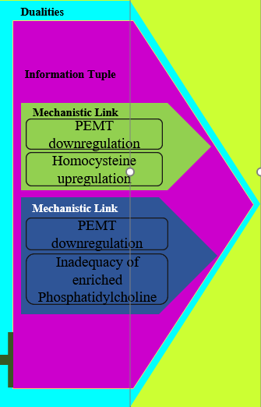
z
z
z
Optimize Costs per customer/IT FTE/business FTE, do more for less, enhance value and efficiency, assuring solvency, return on investment, Worker/Customer/Stakeholder Intimacy, while achieving charter objectives and delivery on Key performance indicators
Internal, programmable, directable, cybernetic, artificial, operational, and organizational synapse using opts, feedback, improvement
External, programmable, directable, cybernetic, artificial, operational, and Industry synapse using ops, feedback, improvement
z
z
z
z
Atypical Cellular Proliferation linked to PSA Levels
Very difficult, large or unresolvable problems become resolved but axioms, tips, tricks, correlates, mechanistic links, homologues or other correlations are produced during proofs because very difficult problems are often fairly simple or uncomplicated to verify.
The resultant heuristic has relevant droplets, columns, shards or variables which perform as bolt on points within a system into which the heuristic will be inferred. The droplets together comprise a tuple.
A mechanistic link is a causal relationship.
A duality is an established relationship between a tuple and an a problem into which a tuple is to be inferred.
The objective is to solve a problem any way possible often by using efficient cheat processes. The NP reduction of an EXP problem produces correlations, relationships, mechanistic links, all as an information tuple.
Bolting these derivatives or tuples onto other problems using similar characteristics as dualities, enables EXP to NP reduction.
NP complete is essential fast, or P. Pervasively solved problems are diverse characteristics and patterns.
Every Disease
Every Problem
EXP
EXP
EXP
Homocysteine upregulation
PEMT downregulation
NP
NP
NP
Inadequacy of enriched Phosphatidylcholine
Homologues
Homologues
P
P
P
Inference
Inference
Tuple = Variables or Constants used as Bolt On Points for Inferences to other problem
Inferential Duality
Homocysteine upregulation
PEMT downregulation
Inadequacy of enriched Phosphatidylcholine

Slide 21
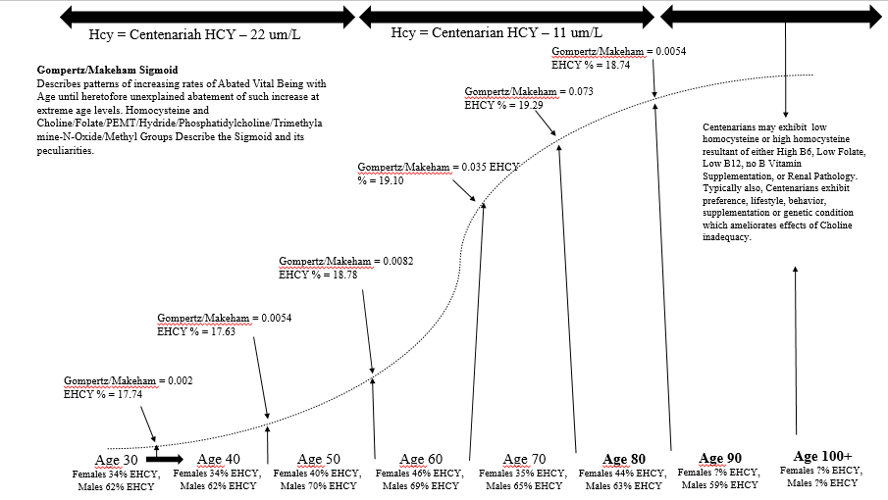
z
z
z
Optimize Costs per customer/IT FTE/business FTE, do more for less, enhance value and efficiency, assuring solvency, return on investment, Worker/Customer/Stakeholder Intimacy, while achieving charter objectives and delivery on Key performance indicators
Internal, programmable, directable, cybernetic, artificial, operational, and organizational synapse using opts, feedback, improvement
External, programmable, directable, cybernetic, artificial, operational, and Industry synapse using ops, feedback, improvement
z
z
z
Mechanistic Links
Bolt On Inferential Points, Finding Dualities
Inferential Duality
Inferential points and data can be utilized to infer the correlates, graphs, derivatives, mechanistic links of one problem or solution into another problem or solution, rapidly reducing the problem from NP to P but also causing emergence of numerous mechanistic links, correlations, derivatives and answers.
NP
Shards
Mechanistic Links, Shards, Columns, or Correlates involve homocysteine, PEMT, enriched phosphatidylcholine, factors causing these or factors resultant of these? Are graphs or derivative output(actuals, training data or unsupervised learning) positively or inversely correlated. Does the problem or subject include PSA levels, any disease or any NP problem? Does imputing any of these as answers result in an NP to P reduction? Etc.
Bolt On Inferential Points
Homocysteine upregulation
Column
PEMT downregulation
Inadequacy of enriched Phosphatidylcholine
Inferential Dualities
Atypical Cellular Proliferation linked to PSA Levels
Every Disease
Every Problem
Derivatives and Graphs
Correlates
Derivative
P

Slide 22
z
z
z
Optimize Costs per customer/IT FTE/business FTE, do more for less, enhance value and efficiency, assuring solvency, return on investment, Worker/Customer/Stakeholder Intimacy, while achieving charter objectives and delivery on Key performance indicators
Internal, programmable, directable, cybernetic, artificial, operational, and organizational synapse using opts, feedback, improvement
External, programmable, directable, cybernetic, artificial, operational, and Industry synapse using ops, feedback, improvement
z
z
z
1298200A Registered Inferential Duality, Tuple, Correlation and Mechanistic Link
Story
Inferential Dualities
Bolt On Inferential Points
The Register Inferential, Duality, Tuple with Mechanistic Link 1298200A exhibits homocysteine, the enzyme PEMT and enriched phosphatidylcholine. Mechanistic links exist as PEMT downregulation causing upregulation of homocysteine and PEMT downregulation causing inadequacy of enriched version of phosphatidylcholine. Information tuples exists as these mechanistic links. Dualities exist as the ability to infer PEMT status, homocysteine levels and phosphatidylcholine status, as these exist in mechanistic links, between atypical cellular proliferation linked to PSA levels, every disease, and the set of all incomplete and complete NP problems. The expression of these relationships as a derivative presents the gompertz sigmoid and makeham sigmoid graphs describing used by pervasive organizations affected by detrimental human outcomes including vital being compared to homocysteine typically exhibited by age. Homocysteine describes both typical and peculiar nuances of the gompertz sigmoid and makeham sigmoid, with nearly 95 to 98 percent or more positive correlation. Managing homocysteine, PEMT and Enriched Phosphatidylcholine beneficially to Human outcomes has the potential to change or abrogate the health status, span of being and behavioral outcomes in the developed world.
Inferential Duality
Inferential Dualities
Atypical Cellular Proliferation linked to PSA Levels
Every Disease
Every Problem
Homocysteine upregulation
PEMT downregulation
Inadequacy of enriched Phosphatidylcholine
Derivative

Slide 23
z
z
z
Optimize Costs per customer/IT FTE/business FTE, do more for less, enhance value and efficiency, assuring solvency, return on investment, Worker/Customer/Stakeholder Intimacy, while achieving charter objectives and delivery on Key performance indicators
Internal, programmable, directable, cybernetic, artificial, operational, and organizational synapse using opts, feedback, improvement
External, programmable, directable, cybernetic, artificial, operational, and Industry synapse using ops, feedback, improvement
z
z
z
1298200A Story Board
Story
A
B
C
D
The Registered Inferential, Duality, Tuple with Mechanistic Link 1298200A exhibits that inhibition of PEMT, increased levels of homocysteine and impaired synthesis of enriched phosphatidylcholine causes cellular entities to perform in an inflammation mode, acting increasingly individual cellular entities instead of participants in tissues, organs or systems. This causes susceptibility to massive apoptosis that deteriorates neurological tissues required for rewards systems function, conditioning, recall, condition blocking, conscious capacitant fields able to withstand external influence, memory, associations, all in a way that causes circulatory pathways to become changed in a way that enhances the brain stem and amygdala ability to transmit signals in response to primitive cues that enable finding of sources of nutrients, choline and methyl groups. These enhance susceptibility to disease, detrimental behavior, addiction and compulsion because the brain is able to make less than conscious associations to factors exhibiting methyl groups and choline as well as those exhibited factors that cause the brain to conclude that essential pathways are obtaining sustenance, which in the context explained here causes complete physiology to become trained or conditioned toward crisis mode allocation of physiological systems along deregulated genomic management and social function.
Star Proteins perform shielded transfer of Cholesterol from membranes to Mitochondria
Mitochondrial PEMT2 (beginning near conclusion and after gestation) and Endoplasmic Reticulum PEMT1 (before conception) use newly synthesized unglycosylated/slightly glycosylated phosphatidylethanolamine's three open locations (connected to Nitrogen) to sequentially attach 3 molecules of CH3 or methyl groups
Enriched phosphatidylethanolamine exhibits extended length arachidonate, omega-3 fatty acids, antiinflammatory fatty acids, DHA, ether linked fatty acids for insulation, palmitate first fatty acid in fatty acid beta oxidation, and oleoylate.
PEMT attachment of CH3 with 1 hydride to 2 Hydrogens enables hundreds of mitochondria in each cellular entity to exhibit capacitant fields required for 7.2 to 7.6 background ph required for conscious cognitive function and sustainable vital being.
Cytochrome P450 scc performs translation of cholesterol into the original steroidogenesis enabler and choline kinase alpha upregulator Pregnenolone
AP1 inhibits PEMT catalysis and AP1 is upregulated by Estrogen Receptor Alpha from within the Estrogen Response Element while AP1 is downregulated by Estrogen Receptor Alpha
Hydride, the energy that fuels stars, is exhibited in a 1 to 2 ratio with Hydrogen or 1 of 3.
PEMT attaches CH3 to produce PMME, then attaches CH3 to PMME to produce PDME, followed by attaching of another CH3 to produce enriched phosphatidylcholine
Pregnenolone translated into glucocorticosteroids, hydroxysteroids, androgens, estrogens, estetrol, estriol, estradiol and estrone
Phosphatidylethanolamine Methyltransferase 1, 2 and 3 are transactivated from within the Estrogen Response Element
PEMT inhibition upregulates homocysteine, abates synthesis of Enriched Phosphatidylcholine, increase BAX to cause massive apoptosis that is opposed by choline kinase alpha, CDP choline Pathway, Sphingosine 1 Phosphate, G Protein, GSK3B survival signaling that deteriorates the protection of P53 to begin pervasive disease.
Estrogen receptor alpha and Estrogen receptor beta activated evenly by estradiol, unevenly by estrone, while Estrogen Receptor Alpha is downregulated by Estrogen Receptor Beta
Phosphatidylethanolamine, PMME, PDME, and Phosphatidylcholine are caustic cleaner with strong antihistamine function which enable serine proteases, trypsin, TPA fibrinolysis, sequestration of biotic factors and separation of abiotic phases from biotic phases enabling embryonic plasticity, anatomical repair/regeneration/generation.
Glucocorticosteriods with perfect 13 sequence estrogen response element activate estrogen response element estriol, estradiol and estrone
Phosphatidylserine , Ca2+ and Phosphatidylethanolamine are shuttle into the Mitochondria from Endoplasmic reticulum through Mitochondrial associated membrane (attached to Endoplasmic reticulum)
Hydride, the energy that fuels stars, is exhibited in a 1 to 2 ratio with Hydrogen or 1 of 3 in Methyl Groups

Slide 24
z
z
z
Optimize Costs per customer/IT FTE/business FTE, do more for less, enhance value and efficiency, assuring solvency, return on investment, Worker/Customer/Stakeholder Intimacy, while achieving charter objectives and delivery on Key performance indicators
Internal, programmable, directable, cybernetic, artificial, operational, and organizational synapse using opts, feedback, improvement
External, programmable, directable, cybernetic, artificial, operational, and Industry synapse using ops, feedback, improvement
z
z
z
1298200A Opportunities
The Registered Inferential, Duality, Tuple with Mechanistic Link 1298200A presents the opportunity to identify direct and indirect stimulators of PEMT downregulation, homocysteine upregulation and inadequacy of phosphatidylcholine. Along with these causal factors, there may be an opportunity to ascertain the factors, pathways, conditions and outcomes which emerge resultant of homocysteine upregulation, PEMT downregulation, and enriched phosphatidylcholine inadequacy..
Causes of PEMT downregulation, homocysteine upregulation, and inadequate phosphatidylcholine
Bolt On Inferential Points
Homocysteine upregulation
PEMT downregulation
Inadequacy of enriched Phosphatidylcholine
Pathways, changes, factors or occurrence resultant of PEMT downregulation, homocysteine upregulation, and inadequate phosphatidylcholine

Slide 25
z
z
z
Optimize Costs per customer/IT FTE/business FTE, do more for less, enhance value and efficiency, assuring solvency, return on investment, Worker/Customer/Stakeholder Intimacy, while achieving charter objectives and delivery on Key performance indicators
Internal, programmable, directable, cybernetic, artificial, operational, and organizational synapse using opts, feedback, improvement
External, programmable, directable, cybernetic, artificial, operational, and Industry synapse using ops, feedback, improvement
z
z
z
1298200A Opportunities
Story
Homocysteine upregulation, PEMT downregulation, and status of enriched phosphatidylcholine perform as a lattice that causes suggestibility which can be commandeered by diverse interests in civilization to impute or synthesize inclination, decisions, priorities and outcomes in a way that cause systems, organizations and individuals to shape human outcomes in ways that prioritize external entities and inadequately prioritize Humans. There is an opportunity do direct systems, solutions and organizations toward outcomes that incrementally and comprehensively beneficially influence and affect Human outcomes
Genetics
Exposure to advertisement and acculturation
Social Status
Bolt On Inferential Points
Homocysteine upregulation
Wellness Status
PEMT downregulation
Nutrition
Presumptions at civilization and Population level
Bias and unacknowledged causal factors
Age
Inadequacy of enriched Phosphatidylcholine
Housing Status
Behavioral status
Environment

Slide 26
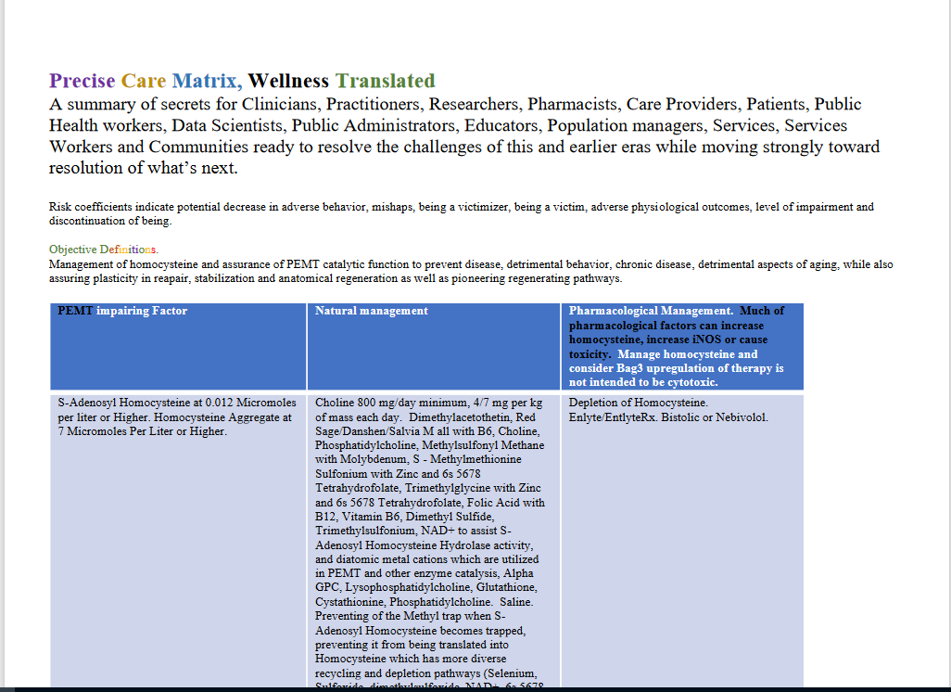
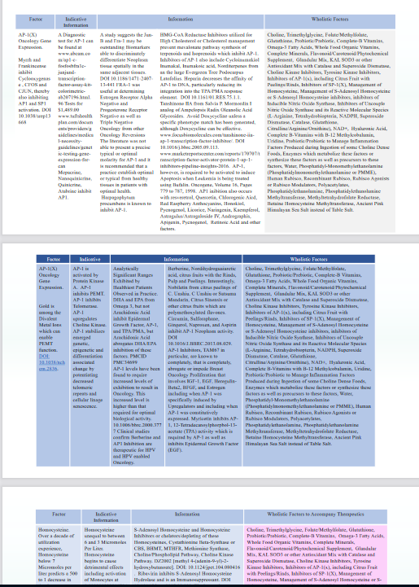
z
z
z
Optimize Costs per customer/IT FTE/business FTE, do more for less, enhance value and efficiency, assuring solvency, return on investment, Worker/Customer/Stakeholder Intimacy, while achieving charter objectives and delivery on Key performance indicators
Internal, programmable, directable, cybernetic, artificial, operational, and organizational synapse using opts, feedback, improvement
External, programmable, directable, cybernetic, artificial, operational, and Industry synapse using ops, feedback, improvement
z
z
z
1298200A Solutions
Story
The Registered Inferential, Duality, Tuple with Mechanistic Link 1298200A presents the solutions Wellness Translated Level 1 Core.pdf and Wellness, Translated, Level 2 Expanded.pdf.
1298200A Solution
Wellness, Translated, Level 1 Core.pdf
Bolt On Inferential Points
Homocysteine upregulation
PEMT downregulation
1298200A Solution
Wellness, Translated, Level 2 Expanded.pdf
Tools, Maps, Matrices, and Care indications.
Inadequacy of enriched Phosphatidylcholine

Slide 27
z
z
z
Optimize Costs per customer/IT FTE/business FTE, do more for less, enhance value and efficiency, assuring solvency, return on investment, Worker/Customer/Stakeholder Intimacy, while achieving charter objectives and delivery on Key performance indicators
Internal, programmable, directable, cybernetic, artificial, operational, and organizational synapse using opts, feedback, improvement
External, programmable, directable, cybernetic, artificial, operational, and Industry synapse using ops, feedback, improvement
z
z
z
1298200A Opportunities
Example Derivative Function Achieve Objective A in correlation to f(x) = X³ - Y² + Z
Graph
Civilizations of the Earth
Release of derivatives in organized, disorganized or less than conscious way into organizational or program operations
Implement Influence to X
Potentiates Activation of f(x) to potentiate achievement of A
Implement Influence to Y
Implement Influence to Z
Foundational Civilization Levels Control Parameters

Slide 28
z
z
z
Optimize Costs per customer/IT FTE/business FTE, do more for less, enhance value and efficiency, assuring solvency, return on investment, Worker/Customer/Stakeholder Intimacy, while achieving charter objectives and delivery on Key performance indicators
Internal, programmable, directable, cybernetic, artificial, operational, and organizational synapse using opts, feedback, improvement
External, programmable, directable, cybernetic, artificial, operational, and Industry synapse using ops, feedback, improvement
z
z
z
1298200A Opportunities
Example Derivative Function Achieve Objective A in correlation to f(x) = X³ - Y² + Z
Civilizations of the Earth
Ignore, disacknowledge and utilization
Graph
PEMT status, Homocysteine status, Choline status, status regarding satisfaction of Human, social, behavioral and physiological requirements while sequestering factors freely obtainable in nature from populations. Reprogramming of human genetics, physiology, metabolism, cognition and behavior to sustain outcomes that sustain status quo, including detrimental Human outcomes
Quota obtainment, objective obtainment, revenue objective obtainment, and massive detrimental human outcomes, particularly when these are linked to or allow benefit to be obtained from detrimental human outcomes
Release of derivatives in organized, disorganized or less than conscious way into organizational or program operations
As much as 90 Million dollars in economic benefit from each imposition
Affect of Abated Being used as a Sanction

Slide 29
z
z
z
Optimize Costs per customer/IT FTE/business FTE, do more for less, enhance value and efficiency, assuring solvency, return on investment, Worker/Customer/Stakeholder Intimacy, while achieving charter objectives and delivery on Key performance indicators
Internal, programmable, directable, cybernetic, artificial, operational, and organizational synapse using opts, feedback, improvement
External, programmable, directable, cybernetic, artificial, operational, and Industry synapse using ops, feedback, improvement
z
z
z
1298200A Opportunities
Example Derivative Function Achieve Objective A in correlation to f(x) = X³ - Y² + Z
Civilizations of the Earth
Graph
Acknowledge, Prioritize, Managed, Mitigate
PEMT status, Homocysteine status, Choline status, status regarding satisfaction of Human, social, behavioral and physiological requirements while sequestering factors freely obtainable in nature from populations. Reprogramming of human genetics, physiology, metabolism, cognition and behavior to sustain outcomes that sustain status quo, including detrimental Human outcomes
Release of derivatives in organized, disorganized or less than conscious way into organizational or program operations
Acknowledge, Prioritize, Manage, Mitigate, Amend, Repeal, Sunset
Massive increase in stability, optimal human outcomes, and span of being, as well as potential for productivity
Affect of Abated Being used as a Sanction

Slide 30
z
z
z
Optimize Costs per customer/IT FTE/business FTE, do more for less, enhance value and efficiency, assuring solvency, return on investment, Worker/Customer/Stakeholder Intimacy, while achieving charter objectives and delivery on Key performance indicators
Internal, programmable, directable, cybernetic, artificial, operational, and organizational synapse using opts, feedback, improvement
External, programmable, directable, cybernetic, artificial, operational, and Industry synapse using ops, feedback, improvement
z
z
z
1298200A Opportunities
Civilizations of the Earth
Foundational Civilization Levels Control Parameters
Allowed Choline Deficiency
Allowed Inhibition of PEMT
90 percent or more of decisions produced less than consciously by systemic interactions
Elevated Homocysteine
iNOS and Phospholipase D from unshielded Electricity, Wireless Communications, environmental Particulate
90 percent or more of decisions produced less than consciously by systemic interactions
Foundational Parameters are an opportunity to understand and improve Human outcomes pervasively
Implementation of abated being as a sanction
Unassured human, social, behavioral and physiological requirements
Massive Consumerism
Sequestration and monetization of nature and water

Slide 31
z
z
z
Optimize Costs per customer/IT FTE/business FTE, do more for less, enhance value and efficiency, assuring solvency, return on investment, Worker/Customer/Stakeholder Intimacy, while achieving charter objectives and delivery on Key performance indicators
Internal, programmable, directable, cybernetic, artificial, operational, and organizational synapse using opts, feedback, improvement
External, programmable, directable, cybernetic, artificial, operational, and Industry synapse using ops, feedback, improvement
z
z
z
1298200A Opportunities
Electrical, wireless communications, atmospheric particulate, allowed choline deficiency, inhibition of PEMT and Homocysteine have participated in deteriorating species specific barriers to pathogens, microbes, disease and behavior. Electricity, wireless communications, satellite communications and increasingly high powered versions have caused physiological structure to be unable to assure protection from environmental factors, including impairin gestational circumstance, resulting in iNOS expression and phospholipase D expression in the luminal tissues and areas of physiology which physiological structure was intended to protect.
Civilizations of the Earth
Foundational Civilization Levels Control Parameters
Allowed Choline Deficiency
Allowed Inhibition of PEMT
Physiology
Elevated Homocysteine
iNOS and Phospholipase D from unshielded Electricity, Wireless Communications, environmental Particulate
Organs, tissues, glands structures
Outside, foundational, basement interstitial, innermost layers facing cavernous areas(epithelial and luminal areas)
Implementation of abated being as a sanction
Unassured human, social, behavioral and physiological requirements
iNOS, phospholipase D, other
Sequestration and monetization of nature and water

Slide 32
z
z
z
Optimize Costs per customer/IT FTE/business FTE, do more for less, enhance value and efficiency, assuring solvency, return on investment, Worker/Customer/Stakeholder Intimacy, while achieving charter objectives and delivery on Key performance indicators
Internal, programmable, directable, cybernetic, artificial, operational, and organizational synapse using opts, feedback, improvement
External, programmable, directable, cybernetic, artificial, operational, and Industry synapse using ops, feedback, improvement
z
z
z
1298200A Opportunities
Civilizations of the Earth
Foundational Civilization Levels Control Parameters
Allowed Choline Deficiency
Allowed Inhibition of PEMT
Economical disadvantaged
Elevated Homocysteine
iNOS and phospholipase D from unshielded electricity, wireless communications, environmental particulate
Escape of these known factors political and social prioritization/agenda. Disparities begin gestationally and at birth with increased risk for disease, abated vital being, complications hundreds of times higher for these populations
Aged
Foundational Parameters are an opportunity to understand and improve Human outcomes pervasively
Developing populations
Implementation of abated being as a sanction
Unassured human, social, behavioral and physiological requirements
Less educated
Gender, other
Sequestration and monetization of nature and water
Ethnic

Slide 33
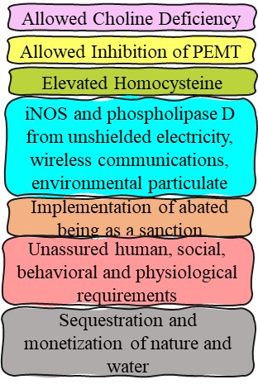
z
z
z
Optimize Costs per customer/IT FTE/business FTE, do more for less, enhance value and efficiency, assuring solvency, return on investment, Worker/Customer/Stakeholder Intimacy, while achieving charter objectives and delivery on Key performance indicators
Internal, programmable, directable, cybernetic, artificial, operational, and organizational synapse using opts, feedback, improvement
External, programmable, directable, cybernetic, artificial, operational, and Industry synapse using ops, feedback, improvement
z
z
z
1298200A Opportunities
Civilizations of the Earth
Foundational Civilization Levels Control Parameters
Economical disadvantaged
Sustained, unhindered economic growth
New Facilities
Aged
New organizations not alleviating empirical cause of detrimental outcomes
Developing populations
Sustained and unhindered economic growth, Pandemics, epidemics, massive behavioral change, massive consumerism, dementia, impaired metabolism, oncology, levels of disease, advancement of disease, more obvious ignoring of empirical cause of disease, production of obfuscating complicating contexts to prevent empirical resolution of causalities, etc
Hospital Bed Made is a hospital bed filled. Increase in resources and facilities causes increase in outcomes to consume such resources. Roemer’s Dynamics
Global, international regional, local organizations not alleviating empirical cause of detrimental outcomes
Decreasing particularity of scapegoatism
Gender, other
Less educated
Ethnic

Slide 34
z
z
z
z
Optimize Costs per customer/IT FTE/business FTE, do more for less, enhance value and efficiency, assuring solvency, return on investment, Worker/Customer/Stakeholder Intimacy, while achieving charter objectives and delivery on Key performance indicators
Internal, programmable, directable, cybernetic, artificial, operational, and organizational synapse using opts, feedback, improvement
External, programmable, directable, cybernetic, artificial, operational, and Industry synapse using ops, feedback, improvement
z
z
z
1298200A Opportunities
Sustained and unhindered economic growth, Pandemics, epidemics, massive behavioral change, massive consumerism, dementia, impaired metabolism, oncology, levels of disease, advancement of disease, more obvious ignoring of empirical cause of disease, production of obfuscating complicating contexts to prevent empirical resolution of causalities, etc. Humans in civilizations where human, social, behavioral and physiological requirements are not freely provided = influences population toward increased demand. Production begins to stimulate demand even beyond equilibrium. Because PEMT inhibition, Homocysteine, increased electricity influence and increased wireless influence cause iNOS, Phospholipase D, other factors inhibition of PEMT, increases homocysteine, ablates higher cognition integration into stimuli and response, redirects stimuli/response to amygdala, causes inhibition of glycolysis by P53 except in actively utilized muscle tissue to produce a canonical focus on excitatory muscle activity/behavior, deteriorating conditioning, areas of the brain required for social behavior, resistance to environmental influences, rewards system, etc. Shapes, tastes, smells, cues leading to factors in nature that alleviate homocysteine are commandeered for advertising, sales, signs, displays, products, services, etc. These factors cause a physiological multiplicity between migration, behavioral changes or physiological changes.
Civilizations of the Earth
Foundational Civilization Levels Control Parameters
Economical disadvantaged
Sustained, unhindered economic growth
New Facilities
Aged
New organizations not alleviating empirical cause of detrimental outcomes
Hospital Bed Made is a hospital bed filled. Increase in resources and facilities causes increase in outcomes to consume such resources. Roemer’s Dynamics
Developing populations
Global, international regional, local organizations not alleviating empirical cause of detrimental outcomes
Decreasing particularity of scapegoatism
Increased electricity, wireless communication, satellite communications migratory behavior, behavioral instability, physiological instability
Gender, other
Less educated
Ethnic

Slide 35
z
z
z
z
Optimize Costs per customer/IT FTE/business FTE, do more for less, enhance value and efficiency, assuring solvency, return on investment, Worker/Customer/Stakeholder Intimacy, while achieving charter objectives and delivery on Key performance indicators
Internal, programmable, directable, cybernetic, artificial, operational, and organizational synapse using opts, feedback, improvement
External, programmable, directable, cybernetic, artificial, operational, and Industry synapse using ops, feedback, improvement
z
z
z
1298200A Opportunities
The foundational parameters emerged as modalities of assuring, confirming and sustaining biased outcomes and sustaining objectives, revenue objectives, quotas and other outcomes which require detrimental human outcomes in order to be obtained. These foundational parameters become encompassed by acculturation, obfuscation, obscuring contexts, and other pervasively exhibited mechanisms, association, biases, and omittances in a way that seems to have emerged innocently, ignored when the correlates should have been acknowledged, utilized to continue conformation of bias, and then, in the 2000s, emerged as uncontrollable influences affecting populations other than those whom were easily made dispensable to scapegoatism because of susceptibilities, resulting in detrimental effect that was no longer relegated to scapegoated populations. Most imperatively, after interspersion of diverse groups among one another, wireless, satellite, electricity, particulate/pollution, and inhibition of PEMT along with homocysteine persist disparate outcomes among scapegoated populations because these affect darker feature, older, health condition exhibiting, risk factor exhibiting, less fortunate populations. These are exacerbated by exhibition of massive benefit being obtained from these populations in context in which how and why these factors are affecting them is being withheld.
Civilizations of the Earth
Foundational Civilization Levels Control Parameters
1800s to early 1900s
Early 1900s
1900s
2000s
Massive changes to distribution of human outcomes emerges consistent with Electricity, Wireless communications, pollution. Discovery of dimethylthetin which decreases homocysteine not acknowledged or utilized
Viral and Microbial conditions begin to emerge and move from other organisms into Human populations. What was principally homocysteine, PEMT as foundations for disease and detrimental behavior.
Foundational parameters are allowed to increase each year and become nearly perfectly correlated with abated vital being, but allow massive consumerism, demand to increase according to availability of products or services.
Because the affects these unmanaged factors was distributed at increased levels among scapegoated populations, these could be used to produce confirmation of bias and revenue, such that dimethylthetin metabolism pathways but not dimethylthetin was used to produce pervasive drugs in the 1900s
Increasing integration of different groups is counteracted by electricity and wireless communications which increasedly effects darker featured, genetically specific, culturally specific populations. Electricity and wireless become tools to persist biased outcomes and cannot be acknowledged because these are means of persisting bias, confirming bias, achieving quotas, revenue objectives.
Populations begin to be affected by pervasive conditions that require, are exacerbated by or are pathogenically hastened or amplified by iNOS and phospholipase D among other factors. Massive changes to behavior and physiology emerge as outcomes associated with risk factors that are correlated to scapegoated populations. These are utilize to confirm bias and prevent social change/improvement.

Slide 36
z
z
z
Optimize Costs per customer/IT FTE/business FTE, do more for less, enhance value and efficiency, assuring solvency, return on investment, Worker/Customer/Stakeholder Intimacy, while achieving charter objectives and delivery on Key performance indicators
Internal, programmable, directable, cybernetic, artificial, operational, and organizational synapse using opts, feedback, improvement
External, programmable, directable, cybernetic, artificial, operational, and Industry synapse using ops, feedback, improvement
z
z
z
1298200A Opportunities
These present clearly that civilizations have a interest foundationally included in detrimental aspects of the status quo to select the most detrimental manner of resolving human requirements, civilization requirements, and other challenges, because these have, in earlier eras, resulted in massive confirmation of the status quo. These have resultant in inadequate safety assurances regarding the effect of these modalities to human populations and has allowed sustained increases of the cytokines required by pathogens, disease, detrimental behavior, microbes, epidemics and pandemics. Observing how long the capabilities for producing water and energy with virtually no environmentally detrimental effect, presents how long unnecessary detriment to environment and human populations has persisted. The opportunities intended for the newly discovered western hemisphere has always been to elute benefit for humanity more empirically, more purely, more pervasively and most safely from what was the wilderness and what was the incipient knowledge that existing populations of the western hemisphere had already produced in understanding, managing and assuring sustainability of natural resources. The value proposition of products and services now have myriad new dimensions and myriad new possibilities. The costs and affects to human populations of bias, pervasively imposed and acculturated upon humanity and systems, are incalculable in this context.
Political systems and even democracies exhibit the potential for less than majoritarian groups to become scapegoated through social constructs, bias, perception, opinion, electoral and other processes, even when these can cause massively detrimental focused outcomes. These are a major source of potential value for programs, products and services.
Civilizations of the Earth
Foundational Civilization Levels Control Parameters
2000s
2000s
Production of Water from atmosphere at 500,000 or more liters each day. www.waterfromatmosphere.com
Permanent management generation of resourceless, wasteless, nonpolluting and immediately carbon neutral production of 1000s of megawatts of current for only maintenance costs after incipient implementation. Permanent, sustainable energy at size to energy ratios unimaginable even a few years ago, but which was possible hundreds of years ago. Calnetix.com presents permanent, resourceless, wasteless, nonpolluting energy production efficiencies of 13 kW/kg and 43 kW/liter. c
Regardless of this remarkable capability that has always been possible and has been feasible for decades, civilizations continuously choose to implement that most invasive, wasteful, expensive, and detrimental ways of managing water resources for populations, particularly because doing so promotes bias confirmation and enables benefit to be obtained from detrimental outcomes.
Civilizations have continuously chosen the most risky, most polluting and most detrimental modalities of energy production because these confirm biases, produce massive detriment that can be benefited from and enable production of massive waste, some of which can be utilized to assist in production of massively detrimental artifacts often providing nations that are not able to sustain their own populations with the opportunity to regressive global systems into past eras of potential destabilization and was well potential abrogation of massive aspects of human populations.
These introduce how interactions within systems and processes can occur in a way that prioritizes systems over their incipient purpose, utility, over humanity and over satisfy value in the deep xValue dimension and the deeper yValue dimension.

Slide 37
z
z
z
z
Optimize Costs per customer/IT FTE/business FTE, do more for less, enhance value and efficiency, assuring solvency, return on investment, Worker/Customer/Stakeholder Intimacy, while achieving charter objectives and delivery on Key performance indicators
Internal, programmable, directable, cybernetic, artificial, operational, and organizational synapse using opts, feedback, improvement
External, programmable, directable, cybernetic, artificial, operational, and Industry synapse using ops, feedback, improvement
z
z
z
1298200A Opportunities
More products, more services, deeper value (x,y), satisfy hidden valences, provide enabling solutions to achieve what life should and could be
Sustained, unhindered economic growth
Civilizations of the Earth
The value proposition for products and services has expanded beyond satisfying conscious nuances of human priorities, reaching satisfaction of less than conscious nuances of human priorities and extending toward satisfying foundational nuances of human, social, behavioral and physiological requirements including sustainability, environmental priorities, quality, stability and empowerment of humans. Western civilizations are known to have the most successful products be linked to or represent homologues to physiology and esoteric factors in physiology. Information technology development and other organizations are known to present strong homologues to increasingly esoteric and intricate nuances of physiology and biology. This suggests that organizations have for some time integrated hidden benefits, particularly knowledge and information factors, within products and services. Often, these would be able to disrupt the status quo, such that integrating such knowledge into products and services may have been able to cause advancement in research, development, products and services, particularly during eras when the status quo would not be displaced even when information and data clearly provided an impetus to do so.
Foundational Civilization Levels Control Parameters
Why consumers think they make decisions.
Value
xValue
yValue
Deep
Value
Why, analytically, consumers actually make decisions.
Favor intended for humanity by the Universes including quality of being, stability, sustenance and assured being

Slide 38
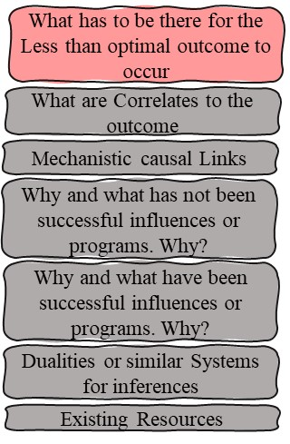
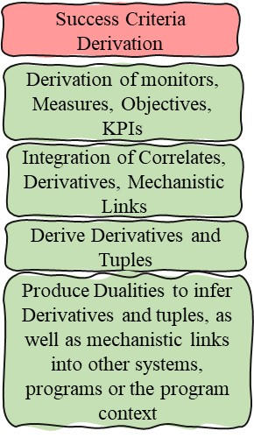
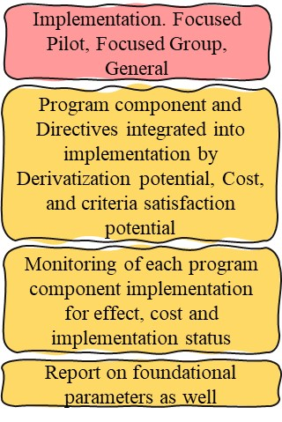
z
z
z
Optimize Costs per customer/IT FTE/business FTE, do more for less, enhance value and efficiency, assuring solvency, return on investment, Worker/Customer/Stakeholder Intimacy, while achieving charter objectives and delivery on Key performance indicators
Internal, programmable, directable, cybernetic, artificial, operational, and organizational synapse using opts, feedback, improvement
External, programmable, directable, cybernetic, artificial, operational, and Industry synapse using ops, feedback, improvement
z
z
z
1298200A Opportunities
Focusing Events, inaccurate opinion, bias, unempirical understanding, ignoring of empirical causality, focus on proximate factors, omitting of systemic shaping of outcomes
Civilizations of the Earth
Foundational Civilization Levels Control Parameters
Control or control for these factors to prevent commandeering of program priorities
Each success elutes new or more intricate causalities and mechanistic links regarding human and social requirements. Foundational Parameters in this regard can be an opportunity to understand and improve Human outcomes pervasively. Information technology has an increased potential to elute the factors in correlation with the success of organizations, initiatives and capabilities.

Slide 39
z
z
z
Optimize Costs per customer/IT FTE/business FTE, do more for less, enhance value and efficiency, assuring solvency, return on investment, Worker/Customer/Stakeholder Intimacy, while achieving charter objectives and delivery on Key performance indicators
Internal, programmable, directable, cybernetic, artificial, operational, and organizational synapse using opts, feedback, improvement
External, programmable, directable, cybernetic, artificial, operational, and Industry synapse using ops, feedback, improvement
z
z
z
Opportunities
This analytic process is both encompassed in software and implemented as operational infrastructure. It is designed to engineer why it is that every analytic process has difficulty reaching empirical observation, analysis, and understanding of areas of inadequacy, challenges, or opportunities. Essentially, why it is that every capability in therapeutics or nutrition, as well as wellness have not been able to conclude a role for PEMT function and its linked factors as essential to health and behavior.

Slide 40
z
z
z
Optimize Costs per customer/IT FTE/business FTE, do more for less, enhance value and efficiency, assuring solvency, return on investment, Worker/Customer/Stakeholder Intimacy, while achieving charter objectives and delivery on Key performance indicators
Internal, programmable, directable, cybernetic, artificial, operational, and organizational synapse using opts, feedback, improvement
External, programmable, directable, cybernetic, artificial, operational, and Industry synapse using ops, feedback, improvement
z
z
z
Systemic, Intraorganizational, Interpopulation and Human Context or Synapse
Systemic, Intraorganizational, Interpopulation and Human Context or Synapse
External Synapse
Translation of internal synapse into external Tensors, Sigmoid, Derivatives, and effect
Artificial Intelligence, Machine Learning, Robotic Process Engineering and Data Science seem to be most useful when a system interacts with, affects and responds to its internal, external, and other nuances of environment.
Internal Synapse
Organizational, Charter, Departmental, Procedural, Rules, Routine Algorithms, Tensors, Sigmoid, and Derivatives
f=X²Y²+7
f=X²Y²+7

Slide 41
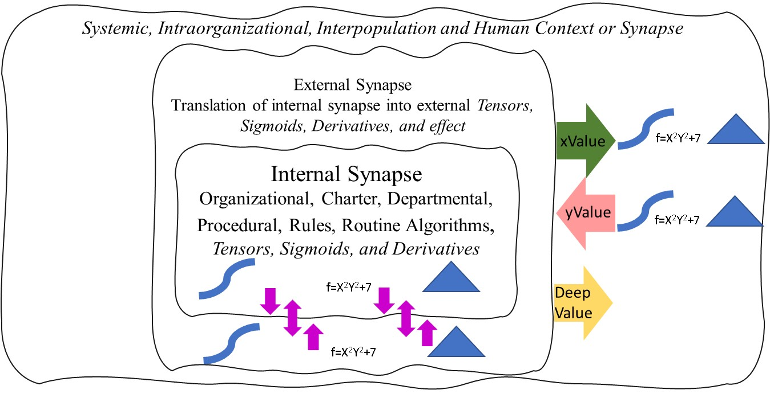
z
z
z
Optimize Costs per customer/IT FTE/business FTE, do more for less, enhance value and efficiency, assuring solvency, return on investment, Worker/Customer/Stakeholder Intimacy, while achieving charter objectives and delivery on Key performance indicators
Internal, programmable, directable, cybernetic, artificial, operational, and organizational synapse using opts, feedback, improvement
External, programmable, directable, cybernetic, artificial, operational, and Industry synapse using ops, feedback, improvement
z
z
z
Systemic, Intraorganizational, Interpopulation and Human Context or Synapse
X
Solutions guided by internal priorities
y
Improved Intimacy with conscious and other than conscious Human decisions toward internal priorities by understanding effect of solutions and activities
Rapidly delivering quality positive valences among workers, customers, systems and populations and enabling others in this capacity
Deep
Integration of externalities or indirect effects, Population, Behavioral, Clinical, Socioeconomic and outcomes level Parameters and datasets

Slide 42
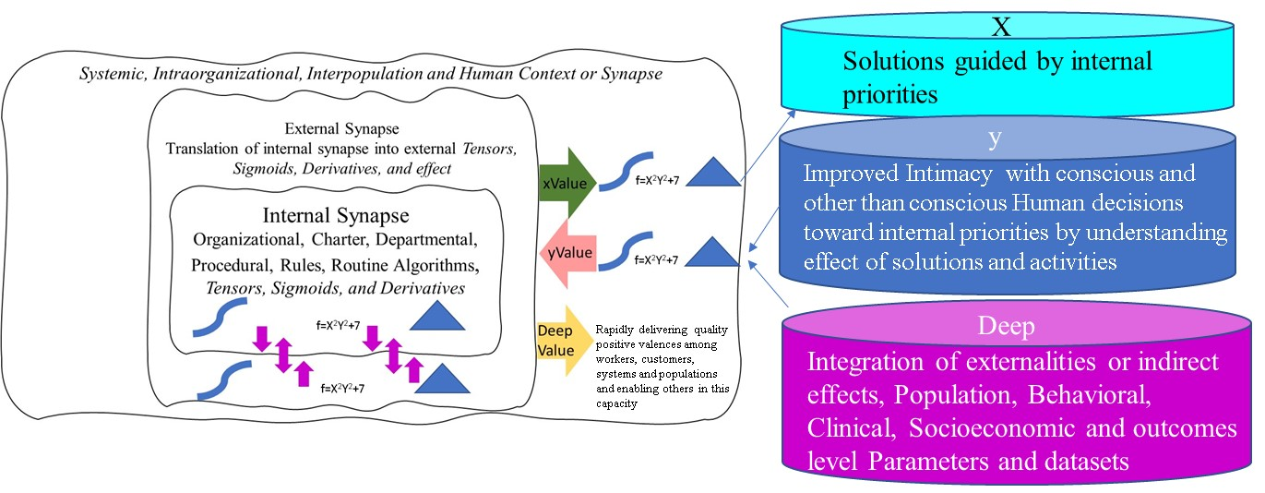
z
z
z
Optimize Costs per customer/IT FTE/business FTE, do more for less, enhance value and efficiency, assuring solvency, return on investment, Worker/Customer/Stakeholder Intimacy, while achieving charter objectives and delivery on Key performance indicators
Internal, programmable, directable, cybernetic, artificial, operational, and organizational synapse using opts, feedback, improvement
External, programmable, directable, cybernetic, artificial, operational, and Industry synapse using ops, feedback, improvement
z
z
z
Human Consciousness
Promote to Consciousness

Slide 43
z
z
z
y, sustain and enhance performance and value
deep, consciously deliver value that is increasingly consciously ascertainable bo workers, customers, populations, systems and as outcomes
Optimize Costs per customer/IT FTE/business FTE, do more for less, enhance value and efficiency, assuring solvency, return on investment, Worker/Customer/Stakeholder Intimacy, while achieving charter objectives and delivery on Key performance indicators
Internal, programmable, directable, cybernetic, artificial, operational, and organizational synapse using opts, feedback, improvement
External, programmable, directable, cybernetic, artificial, operational, and Industry synapse using ops, feedback, improvement
z
z
z
Rapidly delivering quality positive valences among workers, customers, systems and populations and enabling others in this capacity
Optimize Costs per customer/IT FTE/business FTE, do more for less, enhance value and efficiency, assuring solvency, return on investment, Worker/Customer/Stakeholder Intimacy, while achieving charter objectives and delivery on Key performance indicators
deep, consciously deliver value that is increasingly consciously ascertainable bo workers, customers, populations, systems and as outcomes
y, sustain and enhance performance and value
x, establish Correlates, Mechanistic Links, Tensors, Dualities, Sigmoid, Stories, Patterns

Slide 44
z
z
z
y, sustain and enhance performance and value
deep, consciously deliver value that is increasingly consciously ascertainable bo workers, customers, populations, systems and as outcomes
Optimize Costs per customer/IT FTE/business FTE, do more for less, enhance value and efficiency, assuring solvency, return on investment, Worker/Customer/Stakeholder Intimacy, while achieving charter objectives and delivery on Key performance indicators
Internal, programmable, directable, cybernetic, artificial, operational, and organizational synapse using opts, feedback, improvement
External, programmable, directable, cybernetic, artificial, operational, and Industry synapse using ops, feedback, improvement
z
z
z
Outperform original Product, Service, Pattern, Strategy, Campaign in x, y, deep valuative pattern
Product
Service
Wildly
IP
Marketing Strategy
Why and How
Sales Strategy or Campaign
Success?
Marginally
Product or Service
Marketing Campaign
Packaging or Productization
Inadequately
Change
Feature

Slide 45
z
z
z
y, sustain and enhance performance and value
deep, consciously deliver value that is increasingly consciously ascertainable bo workers, customers, populations, systems and as outcomes
Optimize Costs per customer/IT FTE/business FTE, do more for less, enhance value and efficiency, assuring solvency, return on investment, Worker/Customer/Stakeholder Intimacy, while achieving charter objectives and delivery on Key performance indicators
Internal, programmable, directable, cybernetic, artificial, operational, and organizational synapse using opts, feedback, improvement
External, programmable, directable, cybernetic, artificial, operational, and Industry synapse using ops, feedback, improvement
z
z
z
Inherent Propensity for Any System to prioritize itself over its incipient circumstance, Correlative to Duration
Depotentiated, Managed and Mitigated
Inherent Propensity for Any System to prioritize itself over its incipient
Utility or Purpose, Correlative to Duration
Potential for emergence and persistence of detrimental nuances of the status quo
Continuous Management, Monitoring, Analysis, Review and Improvement
Inherent Propensity for systemic nuances to prioritize themselves over Humanity

Slide 46
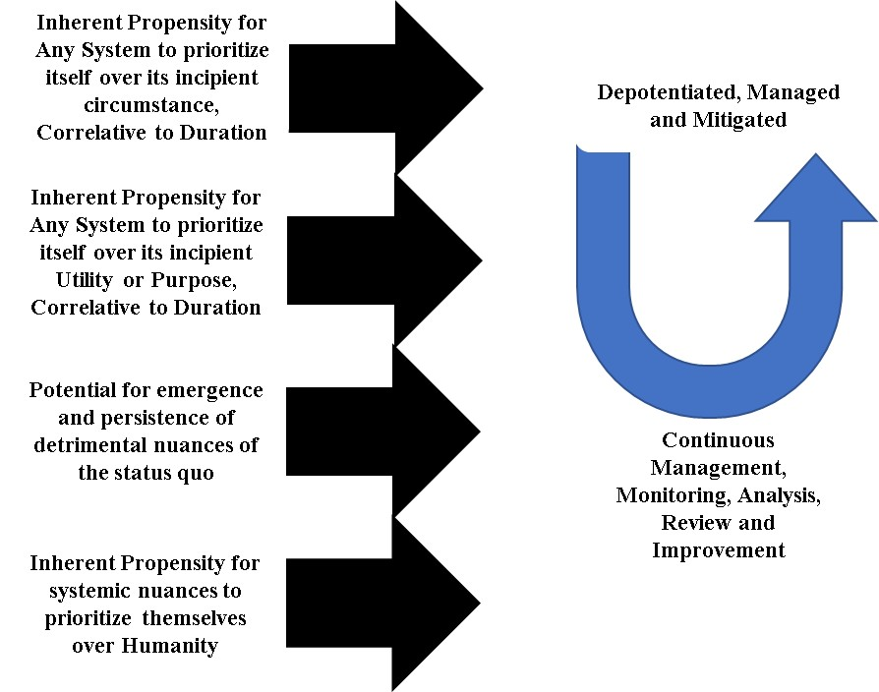
z
z
z
y, sustain and enhance performance and value
deep, consciously deliver value that is increasingly consciously ascertainable bo workers, customers, populations, systems and as outcomes
Optimize Costs per customer/IT FTE/business FTE, do more for less, enhance value and efficiency, assuring solvency, return on investment, Worker/Customer/Stakeholder Intimacy, while achieving charter objectives and delivery on Key performance indicators
Internal, programmable, directable, cybernetic, artificial, operational, and organizational synapse using opts, feedback, improvement
External, programmable, directable, cybernetic, artificial, operational, and Industry synapse using ops, feedback, improvement
z
z
z
Strategy
Systemic
Organizational
Operational
Clinical

Slide 47
z
z
z
xValue, yValue and deepValue Synthesis
y, sustain and enhance performance and value
deep, consciously deliver value that is increasingly consciously ascertainable bo workers, customers, populations, systems and as outcomes
Optimize Costs per customer/IT FTE/business FTE, do more for less, enhance value and efficiency, assuring solvency, return on investment, Worker/Customer/Stakeholder Intimacy, while achieving charter objectives and delivery on Key performance indicators
Internal, programmable, directable, cybernetic, artificial, operational, and organizational synapse using opts, feedback, improvement
External, programmable, directable, cybernetic, artificial, operational, and Industry synapse using ops, feedback, improvement
z
z
z
Manual and Automated Process
Diseases, Behavioral health Conditions, detrimental status, toxins, detrimental contexts horizontal
yValue, Continuous update of story for and understanding of an indicator
Manual and Automated Process
Update Relationship of each Disease/etc on horizontal axis with indicators on the Vertical axis. Codified Character.
Indicators and causal factors used by diseases, toxins, and detrimental Human outcomes to cause detriment, Vertical
Update Relationship of each Indicator on Vertical axis with Diseases/etc on horizontal axis. Codified Character
deepValue, continuous ascertainment of indicators, disease, how the impart detriment, and rapid translation of these into research, development, understanding, care and improve outcomes
xValue, Continuous update of story for A disease/toxin/etc

Slide 48
z
z
z
xValue, yValue and deepValue Synthesis
y, sustain and enhance performance and value
deep, consciously deliver value that is increasingly consciously ascertainable bo workers, customers, populations, systems and as outcomes
Optimize Costs per customer/IT FTE/business FTE, do more for less, enhance value and efficiency, assuring solvency, return on investment, Worker/Customer/Stakeholder Intimacy, while achieving charter objectives and delivery on Key performance indicators
Internal, programmable, directable, cybernetic, artificial, operational, and organizational synapse using opts, feedback, improvement
External, programmable, directable, cybernetic, artificial, operational, and Industry synapse using ops, feedback, improvement
z
z
z
Lateral Moraine
xValue
Lateral Moraine
xValue
Analytics and Datops Tilling
Information and Data Glacier
Analytics and Datops Tilling
deepValue interaction with environment, data obtained from the environment, deep permafrost sources of data, analytic tilling, dataops tilling, improved understanding of data, correlates, mechanistic links, dualities, causalities, improvement organizational or glacial prioritiers , as wel as improving sustainability of environment, biome, and glacial roles or organizational roles in these contexts.
Melted Tundra xValue Accessible by Glacial Tilling and Transport
Permafrost yValue Accessible by Glacial Friction and Transport
Concluding Moraine xValue, yValue Stationary, Retreating and Retilled during Glacial expansion or Movement

Slide 49
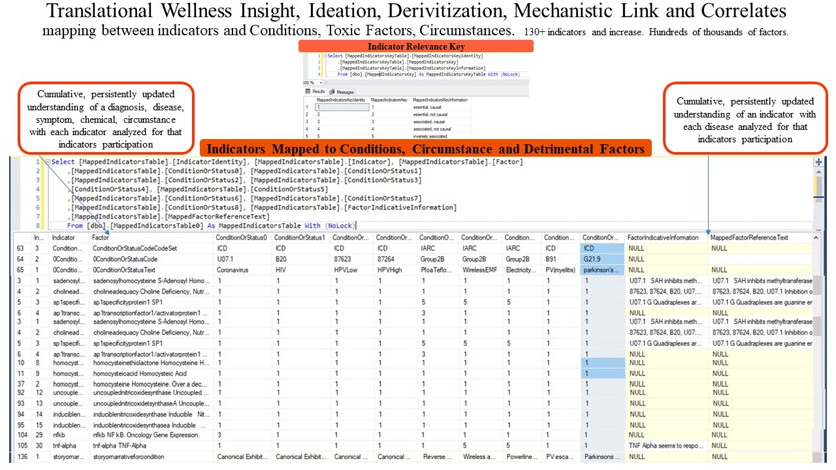
z
z
z
xValue, yValue and deepValue Synthesis
y, sustain and enhance performance and value
deep, consciously deliver value that is increasingly consciously ascertainable bo workers, customers, populations, systems and as outcomes
Optimize Costs per customer/IT FTE/business FTE, do more for less, enhance value and efficiency, assuring solvency, return on investment, Worker/Customer/Stakeholder Intimacy, while achieving charter objectives and delivery on Key performance indicators
Internal, programmable, directable, cybernetic, artificial, operational, and organizational synapse using opts, feedback, improvement
External, programmable, directable, cybernetic, artificial, operational, and Industry synapse using ops, feedback, improvement
z
z
z

Slide 50
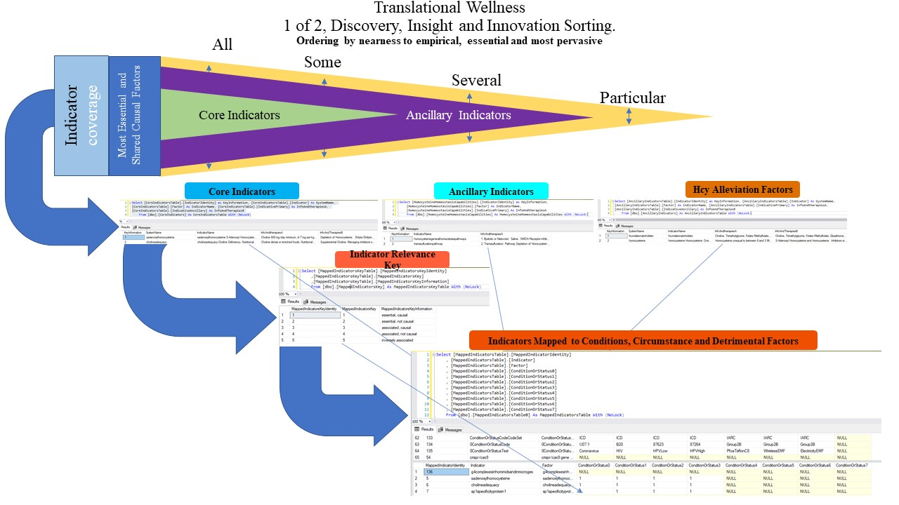
z
z
z
xValue, yValue and deepValue Synthesis
y, sustain and enhance performance and value
deep, consciously deliver value that is increasingly consciously ascertainable bo workers, customers, populations, systems and as outcomes
Optimize Costs per customer/IT FTE/business FTE, do more for less, enhance value and efficiency, assuring solvency, return on investment, Worker/Customer/Stakeholder Intimacy, while achieving charter objectives and delivery on Key performance indicators
Internal, programmable, directable, cybernetic, artificial, operational, and organizational synapse using opts, feedback, improvement
External, programmable, directable, cybernetic, artificial, operational, and Industry synapse using ops, feedback, improvement
z
z
z

Slide 51
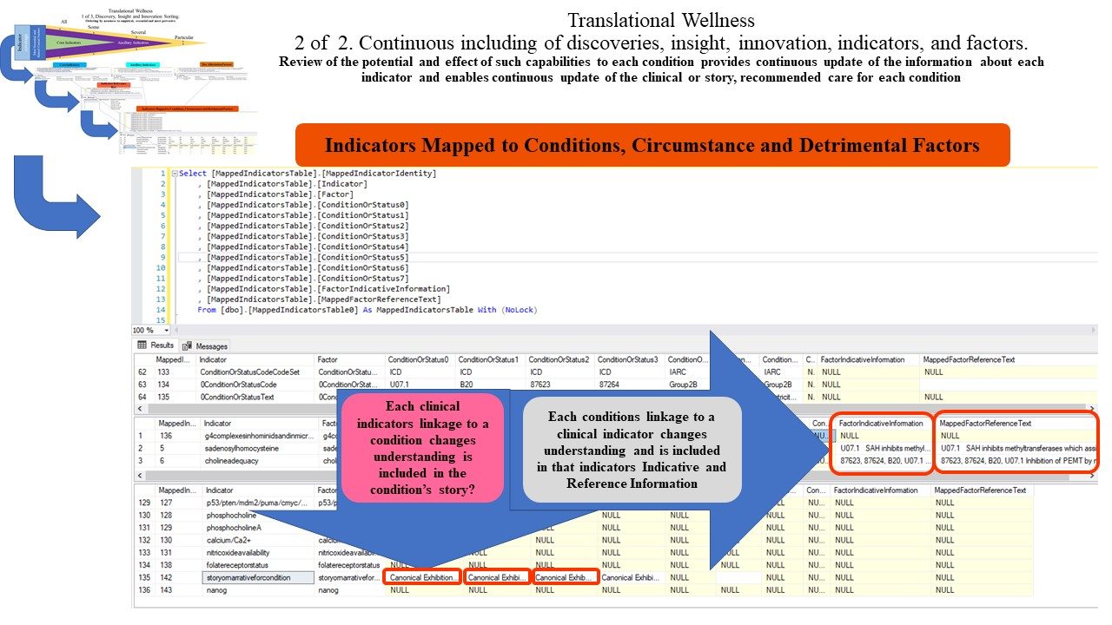
z
z
z
xValue, yValue and deepValue Synthesis
y, sustain and enhance performance and value
deep, consciously deliver value that is increasingly consciously ascertainable bo workers, customers, populations, systems and as outcomes
Optimize Costs per customer/IT FTE/business FTE, do more for less, enhance value and efficiency, assuring solvency, return on investment, Worker/Customer/Stakeholder Intimacy, while achieving charter objectives and delivery on Key performance indicators
Internal, programmable, directable, cybernetic, artificial, operational, and organizational synapse using opts, feedback, improvement
External, programmable, directable, cybernetic, artificial, operational, and Industry synapse using ops, feedback, improvement
z
z
z

Slide 52
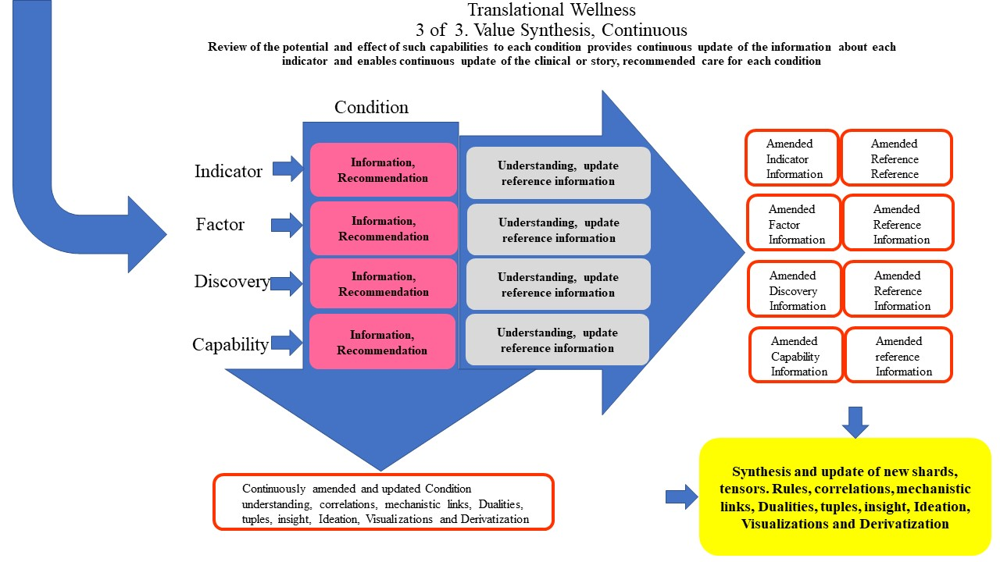
z
z
z
xValue, yValue and deepValue Synthesis
y, sustain and enhance performance and value
deep, consciously deliver value that is increasingly consciously ascertainable bo workers, customers, populations, systems and as outcomes
Optimize Costs per customer/IT FTE/business FTE, do more for less, enhance value and efficiency, assuring solvency, return on investment, Worker/Customer/Stakeholder Intimacy, while achieving charter objectives and delivery on Key performance indicators
Internal, programmable, directable, cybernetic, artificial, operational, and organizational synapse using opts, feedback, improvement
External, programmable, directable, cybernetic, artificial, operational, and Industry synapse using ops, feedback, improvement
z
z
z

